Slide 1


Evidence Based Guideline Review: Bronchiolitis
CME Webinar – June 26, 2019
Jointly presented by:
Amanda Nedved, MD, FAAP
Director of Quality Improvement, Division of Urgent Care
Children's Mercy Hospital
Margaret Thew MSN, FNP-C
Urgent Care Provider
Children’s Hospital of Wisconsin

Slide 2

Amanda Nedved, MD, FAAP:
I have no financial relationships to disclose except that I am employed at Children’s Mercy.
Margaret Thew MSN, FNP-C:
I have no financial relationships to disclose except that I am employed at Children’s Hospital of Wisconsin​.

Slide 3
Objectives
Discuss the burden of bronchiolitis on healthcare
Understand oxygen saturation and its role in disposition decisions
Review the do’s and don’ts of the 2014 AAP Bronchiolitis Guideline
Identify drivers for providers not following the AAP guideline
Review a successful QI project targeting identified drivers

Slide 4
Case 1
Liam is a healthy 2 y/o male who presented to CHW UC with a report of fevers x24 hours, Tmax 103, congestion, and a report of faster breathing than typical. He was eating and drinking per himself with wet diapers.
Family Hx: non-contributory
Physical Findings: Pulse 130, Resp. 48, Temp 38.7, POX 97%
Nursing assessment: “looks fine”
Exam: right ear with effusion, mild erythema
Nasal congestion: Moderate clear rhinorrhea, slight mucosal congestion
Lungs: Occasional expiratory wheeze, no stridor, no retractions, non-productive cough

Slide 5

Question:
Which of the following is the most appropriate treatment for this young man?
A: PO steroids
B: Albuterol trial
C: Chest X-ray
D: Antibiotics
E: No interventions
Notes:
Answer: suction is a reasonable consideration particularly if he has difficulty with drinking or to clear secretions, Albuterol less evidence supports this as no family history or evidence of asthma, CXR: not needed based on POX and exam, Antibiotics: his ear is not infected only fluid present (was he crying?)
No interventions: This is an option as he is hydrated, breathing well, and clears breath sounds with cough.
Bronchiolitis is self limiting and will resolve is a healthy child without interventions.

Slide 6
Case 2
Jon is a12-month-old male with a PMHX of premature 35-week, 3 day. He presents with his Mother to the CHW UC. Mother reports they were seen this afternoon by his PMD due to a non-productive cough, congestion, and fevers of 99 degrees. She reports he had a CXR which was confirmed normal. He was given albuterol in the office 12 hours ago.
Mother has concerns because she hears wheezing and would like albuterol.
Family Hx: Father had asthma as a child
Exam: Pulse 106, Temp 99, Respirations 24, and POX 98%. Generally, playful, growing well with good weight gain since birth, well hydrated with a wet diaper. HEENT: bilateral normal TM, MMM, white nasal drainage, Resp: occasional expiratory wheeze. No stridor or nasal flaring. No use of accessory muscles to breathe.

Slide 7
Question
What are reasons providers do not adhere to the AAP bronchiolitis guidelines?
A: Co-morbid illness with child
B: Parental pressure to provide a treatment
C: Fear of upsetting the parents and losing them as patient
D: The perceived severity of the disease state
E: Lack of familiarity with the guidelines
Notes:
Answer: all the above.

Slide 8
Case 3
Oliver is healthy a 5-month-old male presenting to CHW UC with a report of cough x1 week, reduced breast feeding today, concern for audible wheezing, and Fevers x2 days of 101. Treatment includes Tylenol 1 hour prior to arrival.
Family Hx: non-contributory
Exam: Pulse 140, Resp 50, Temp 100, Pox 97%. He is fussy, but calms to mother, wet diapers, occasional wheezing and non-productive cough, no retractions or use of accessory muscles. Purulent nasal drainage, Left TM buldging, erythema, and dull light reflex.

Slide 9
Question
What is the best management for this young man?
A: Suction and antibiotics
B: Suction, albuterol, and antibiotics
C: Antibiotics only
D: Suction only
E: Do nothing he’s fine
Notes:
Answer A). Antibiotic use with bronchiolitis: Based on the 2014 AAP guidelines on Antibiotic use Clinicians should not administer antibacterial medications to infants and children with a diagnosis of bronchiolitis unless there is a concomitant bacterial infection. (Strong Recommendation)

Slide 10
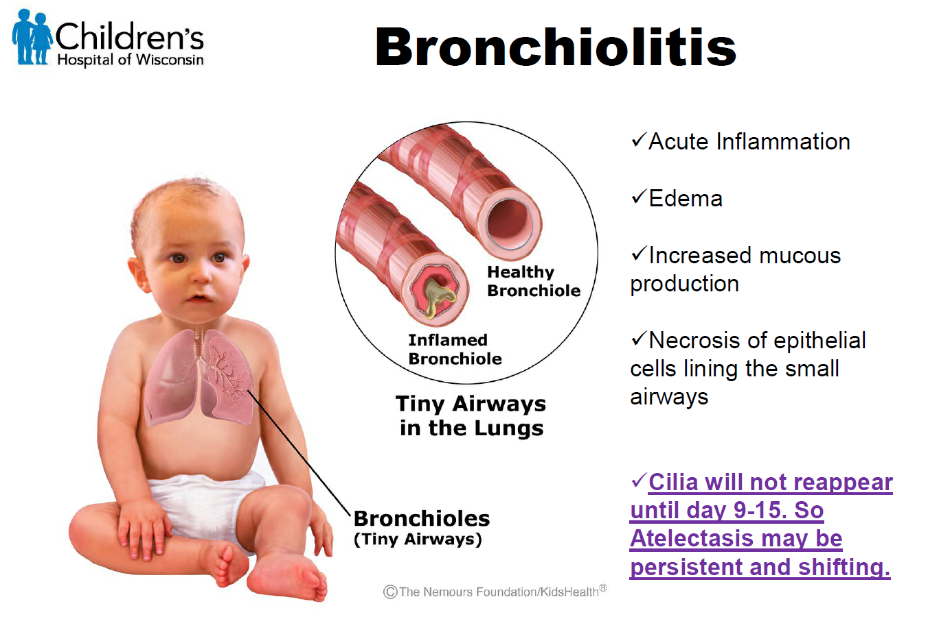
Bronchiolitis What is it?
Bronchiolitis is the most common disease of the lower respiratory tract 0- 24 months. It usually presents with cough with increased work of breathing, and it often affects a child's ability to feed.
Notes:
Approximately 1 in 3 infants will develop clinical bronchiolitis in the first year of life and 2–3% of all infants require hospitalization.
Certain patients are at high risk of respiratory failure or apnea, so recognizing risk factors and signs or symptoms of severe disease is critical
Bronchiolitis is a viral illness of the lower airways, most commonly seen in children less than two years old without a history of previous wheezing. Typically the peak season is December to March/April
It usually begins with 2-3 days of a typical upper respiratory infection symptoms such as nasal congestion or discharge and mild cough, followed by symptoms of fever, increased cough, increased respiratory effort, mild wheezing or crackles, and mild hypoxemia.
Symptoms peak at 5-7 days and may last up to 3 weeks, especially the cough. Treatment is mainly supportive.

Slide 11
Bronchiolitis: What is it?
Bronchiolitis is most commonly seen in children less than two years old without a history of previous wheezing. Typically the peak season is December to March/April.
It usually begins with 2-3 days of a typical upper respiratory infection symptoms such as nasal congestion or discharge and mild cough, followed by symptoms of fever, increased cough, increased respiratory effort, mild wheezing or crackles, and mild hypoxemia.
Symptoms peak at 5-7 days and may last up to 3 weeks, especially the cough. Treatment is mainly supportive.
Possible complications and co morbidities of bronchiolitis include: otitis media (up to 50%), bacteremia (<1-2%), pneumonia (1%) and UTI (1-5%).
Notes:
Approximately 1 in 3 infants will develop clinical bronchiolitis in the first year of life and 2–3% of all infants require hospitalization.
Certain patients are at high risk of respiratory failure or apnea, so recognizing risk factors and signs or symptoms of severe disease is critical

Slide 12
The Burden of Bronchiolitis
Hospital admissions:
  Bronchiolitis is the most common cause of hospitalization among infants in the first 12 months of life.
  There are approximately 100,000 bronchiolitis admissions annually in the USA at an estimated cost of $ 1.73 billion.
Notes:
There are no studies on the effect of short-term brief periods of hypoxemia such as may be seen in bronchiolitis. The Recommendations are WEAK for continuous POX with bronchiolitis based on lower evidence.

Slide 13
The Burden of Bronchiolitis
287,000 emergency department visits each year ​
32%-40% of which end in hospitalization​
6.45% of admissions from ED to inpatient received no major medical interventions and discharge within 12 hours​
Emergency department disposition decisions are subjective due to lack of evidence and objective criteria for bronchiolitis management
Notes:
A study from Intermountain in 2013-2014 showed 6.45% of admissions from ED to inpatient received no major medical interventions and discharge within 12 hours​
Luo G, Johnson MD, Nkoy FL, He S, Stone BL. Appropriateness of Hospital Admission for Emergency Department Patients with Bronchiolitis: Secondary Analysis. JMIR Med Inform. 2018;6(4):e10498. Published 2018 Nov 5. doi:10.2196/10498

Slide 14
Impact of Pulse Oximetry
Introduction of Oximetry
Since 1980, the rate of hospitalization for children with bronchiolitis has increased by nearly 250%, while mortality rates for the disease have remained constant.
Notes:
This is a slide Nate prepared and shared with me…

Slide 15
Pulse Ox and Bronchiolitis
At what % O2 saturation (pulse ox) despite suctioning should a patient with bronchiolitis be hospitalized?

Slide 16
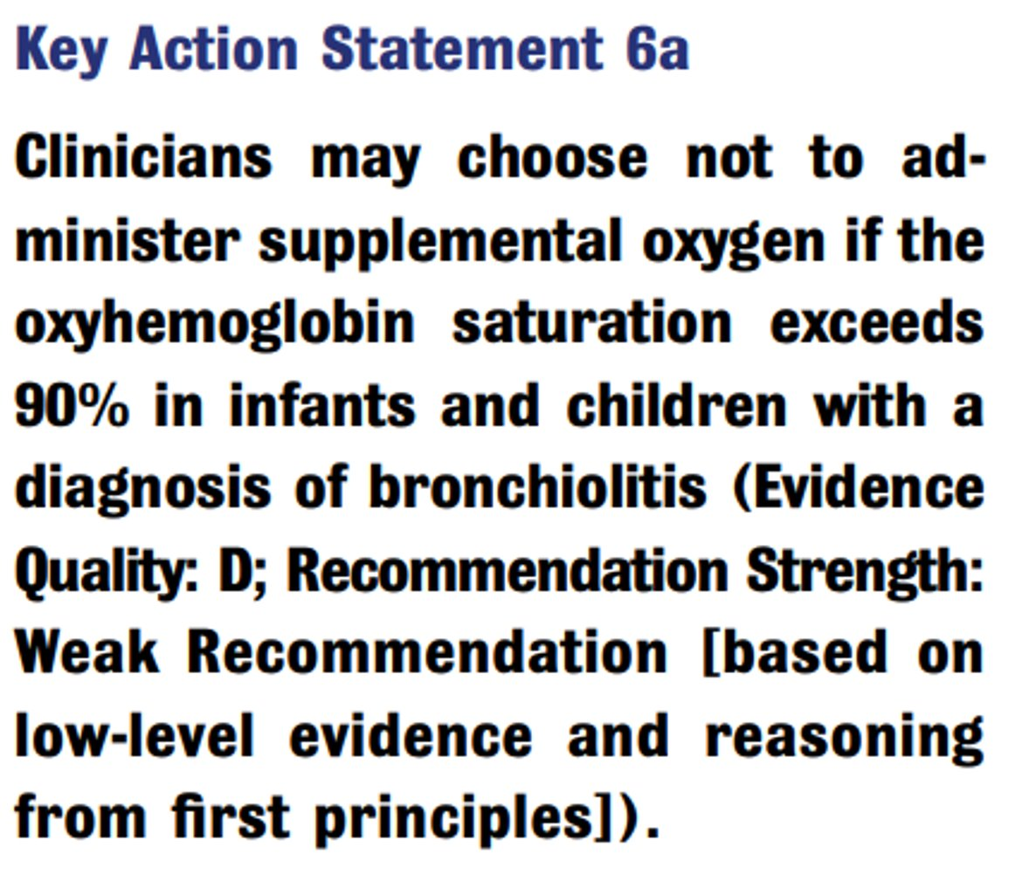
2014 AAP Guideline
Notes:
Note the Quality of Evidence was graded as a D. The recommendation strength was determined to be weak because it was based on low level evidence and reasoning from first principles

Slide 17
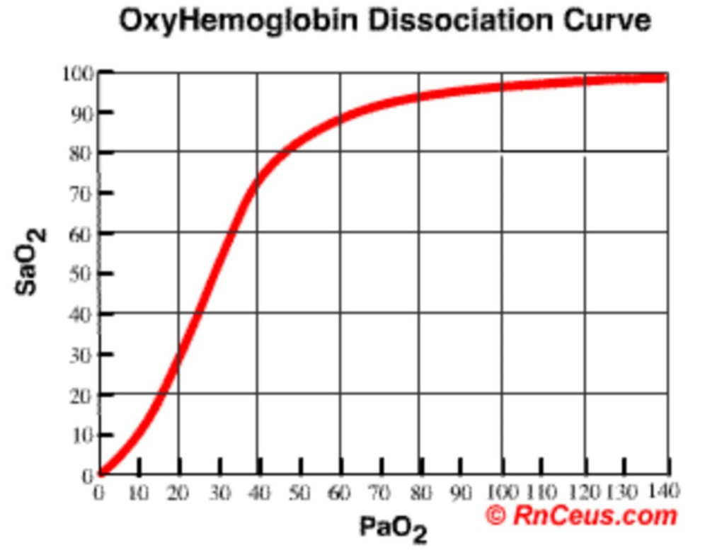
Flashback
Notes:
Experts judged O2 sat of 89% to be adequate to oxygenate tissues and the risk to the patient to be minimal because the OxyHemoglobin Dissociation curve is still relatively flat at this point but develops a steeper slope around 88%. Experts developing the guideline felt the Benefits of decreased hospitalization, LOS and cost outweighed the risk of hypoxemia.

Slide 18
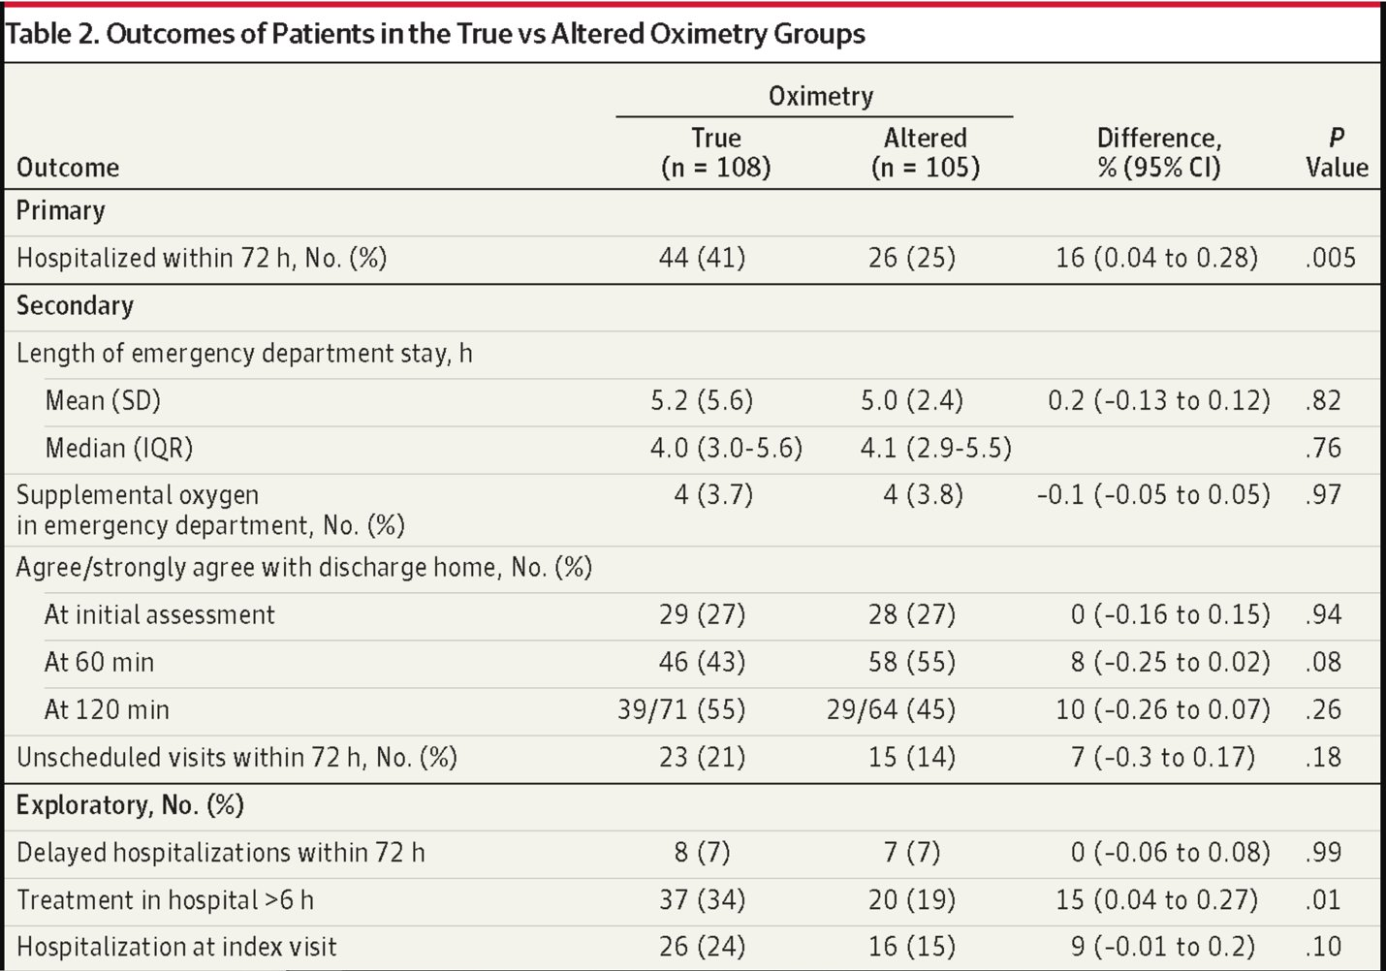
Schuh S, Freedman S, Coates A, et al. Effect of Oximetry on Hospitalization in Bronchiolitis: A Randomized Clinical Trial. JAMA. 2014;312(7):712–718. doi:10.1001/jama.2014.8637​

Slide 19
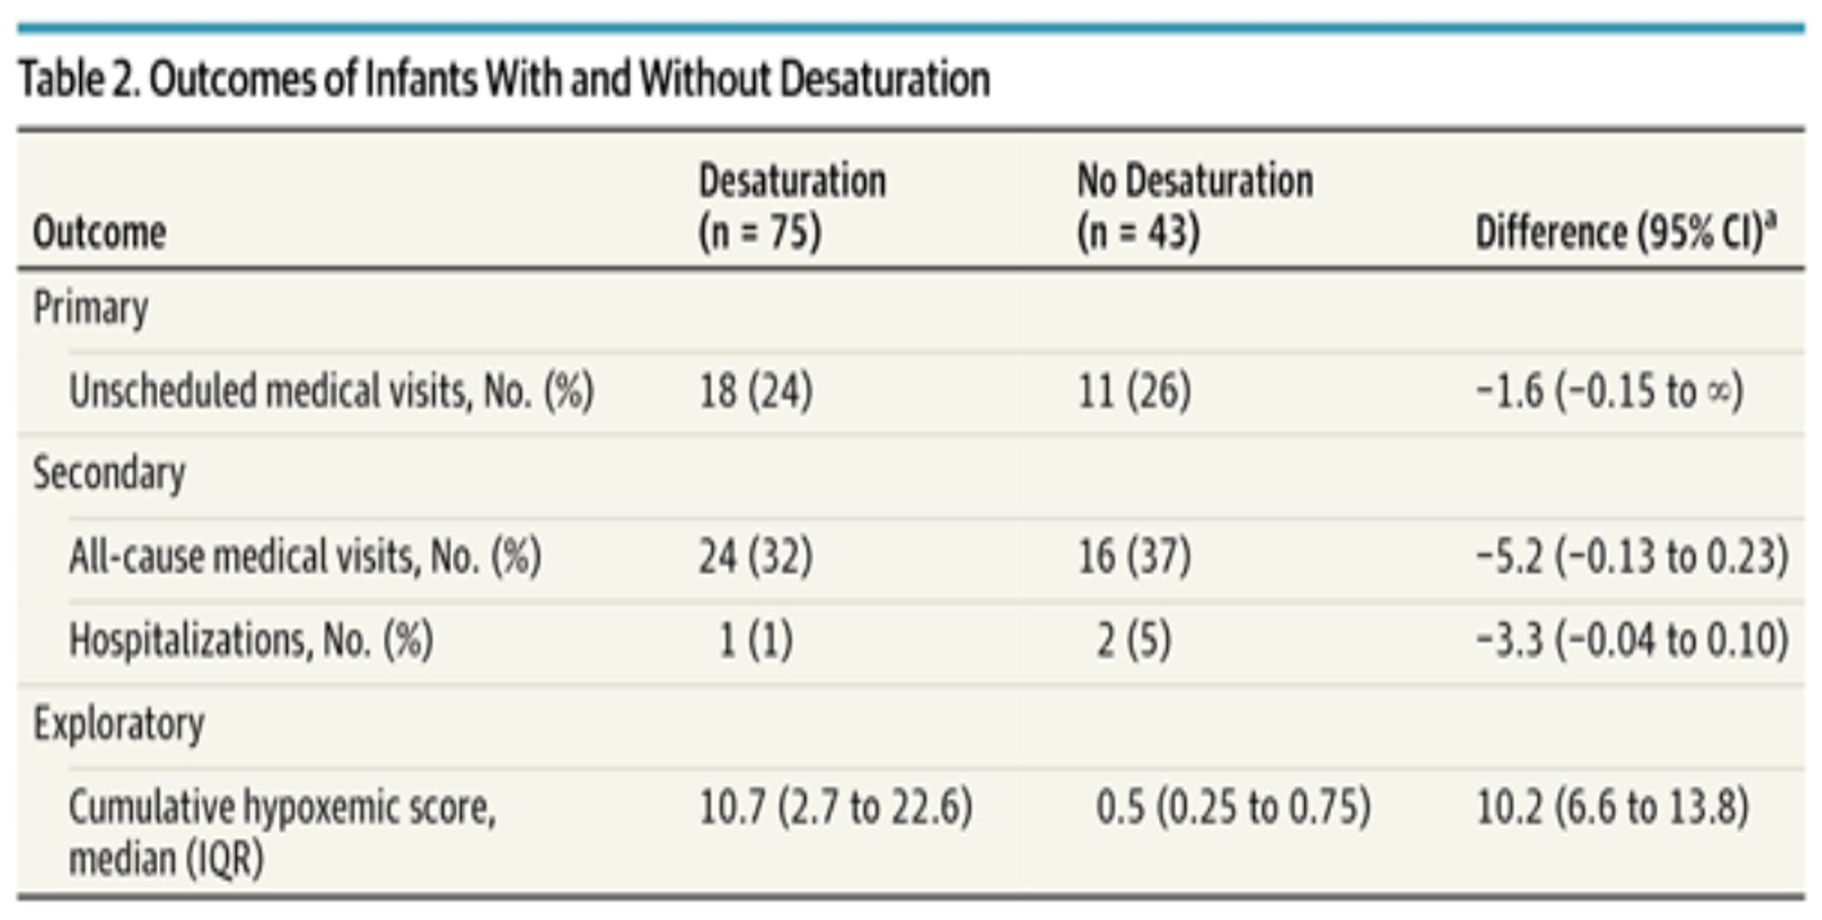
Principi T, Coates AL, Parkin PC, Stephens D, DaSilva Z, Schuh S. Effect of Oxygen Desaturations on Subsequent Medical Visits in Infants Discharged From the Emergency Department With Bronchiolitis. JAMA Pediatr. 2016;170(6):602–608. doi:10.1001/jamapediatrics.2016.0114
Notes:
Another study published in JAMA Pediatrics in 2016, examined patients discharged from the ED with a diagnosis of bronchiolitis. Patients were given a home oxygen monitor for study recording purposes but parents could not see the oxygen saturation reading themselves. Monitoring occurred for the next 24 hours after discharge with a mean of 19 hours of monitoring recorded. In 118 patients enrolled, 64% experienced a desaturation of 90% or less for at least 1 minute with the median desaturation event lasting approximately 3 minutes. There was no difference in unscheduled medical visits or hospitalizations between those who experienced desaturation and those who did not

Slide 20
Take Home Points
Disposition decisions are highly subjective due to lack of high-quality evidence and objective criteria​
Pulse ox is often used as a proxy because it is objective; however, transient hypoxia is common in bronchiolitis as well as healthy children and is well tolerated

Slide 21
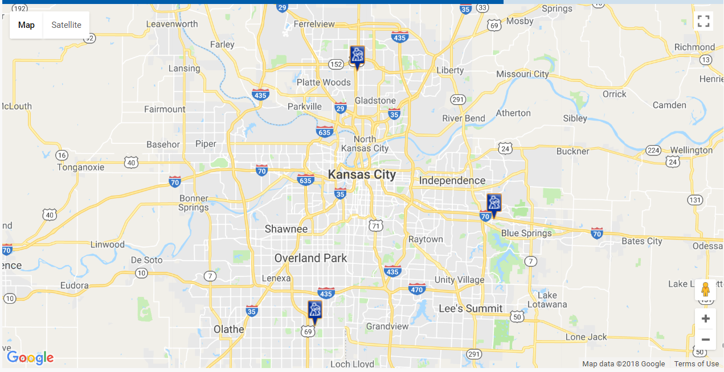
Children’s Mercy Urgent Care
3 Locations
365 days a year
  12:00-22:00 weekday
  10:00-20:00 weekend
Staffed by Board Certified Pediatricians and APRNs
RT available

Slide 22
Children’s Mercy Urgent Care
2015-2016: 82,000 patient encounters
  902 bronchiolitis encounters
2017-2018: 91,000 patient encounters
  1,363 bronchiolitis encounters
Notes:
We started this bronchiolitis QI project in 2015-2016 looking at baseline data

Slide 23
2014 AAP Guidelines
“Do”s
“Do Not Routinely”s
Diagnose bronchiolitis based on H&P
Assist with hydration if necessary
Wash your hands and encourage everyone else to wash their hands too
Discuss smoking cessation
Encourage exclusive breastfeeding for first 6 months
Educate everyone about bronchiolitis
Get CXRs or labs
Give bronchodilators
Give epinephrine
Give hypertonic saline in the outpatient setting
Give steroids
Use chest physiotherapy
Give antimicrobials
Clinical Practice Guideline: The Diagnosis, Management, and Prevention of Bronchiolitis
Shawn L. Ralston, Allan S. Lieberthal, H. Cody Meissner, Brian K. Alverson, Jill E.Baley, Anne M. Gadomski, David W. Johnson, Michael J. Light, Nizar F. Maraqa, Eneida A. Mendonca, Kieran J. Phelan, Joseph J. Zorc, Danette Stanko-Lopp, Mark A. Brown, Ian Nathanson, Elizabeth Rosenblum, Stephen Sayles, Sinsi Hernandez-Cancio
Pediatrics Nov 2014, 134 (5) e1474-e1502; DOI: 10.1542/peds.2014-2742
Notes:
Which guidelines do you think your organization follows really well? Which guidelines do you think your organization has opportunity for improvement?

Slide 24
Humor Break
http://likelihoodratio.blogspot.com/2014/11/the-aaps-donts-and-donts-of.html

Slide 25
Baseline Data
Overall CPG Compliance: 35%
  Albuterol use: 23%
  Chest XR: 22%
  Viral Testing (rapid RSV): 29%
  Antibiotics: 14%

Slide 26
Why don’t providers follow the guideline?

Slide 27
Drivers
Family request for tests and therapies (labs, CXR, antibiotics, steroids, and albuterol)
Caregivers’ knowledge of AAP guideline
Inconsistent power plan use by providers
Health care culture – “I feel like I need to do something.”
Interdisciplinary communication (RT, nursing, ED providers, hospitalist)
Providers’ knowledge of cost

Slide 28
Plan: Aim
In order to improve compliance with the AAP bronchiolitis guideline, we aimed to improve the compliance with the AAP guidelines in patients >60 days to <24 months from 35% to 55% by April 2017. Compliance means none of the 8 listed interventions were ordered during the encounter and we will also look for downward trends in each test or medication:
    Respiratory panel PCR Antibiotics
    Rapid RSV Corticosteroids
    CXR Bronchodilators
    CBC Blood culture
Notes:
Recognizing that the goal should never be 100% compliance as some patients with bronchiolitis do need these medications and tests

Slide 29
Plan: Measures
Process measures:
1. Bronchiolitis Order Set Use
2. Bronchiolitis Family Education Order
Outcome measures:
CPG compliance = Reduce overutilization of the following interventions (Bundle):
    Respiratory panel PCR Antibiotics
    Rapid RSV CXR
    Bronchodilators Blood Tests (CBC/Blood Culture)Blood culture
    Balancing measure: Cost, LOS, and rate of admission

Slide 30
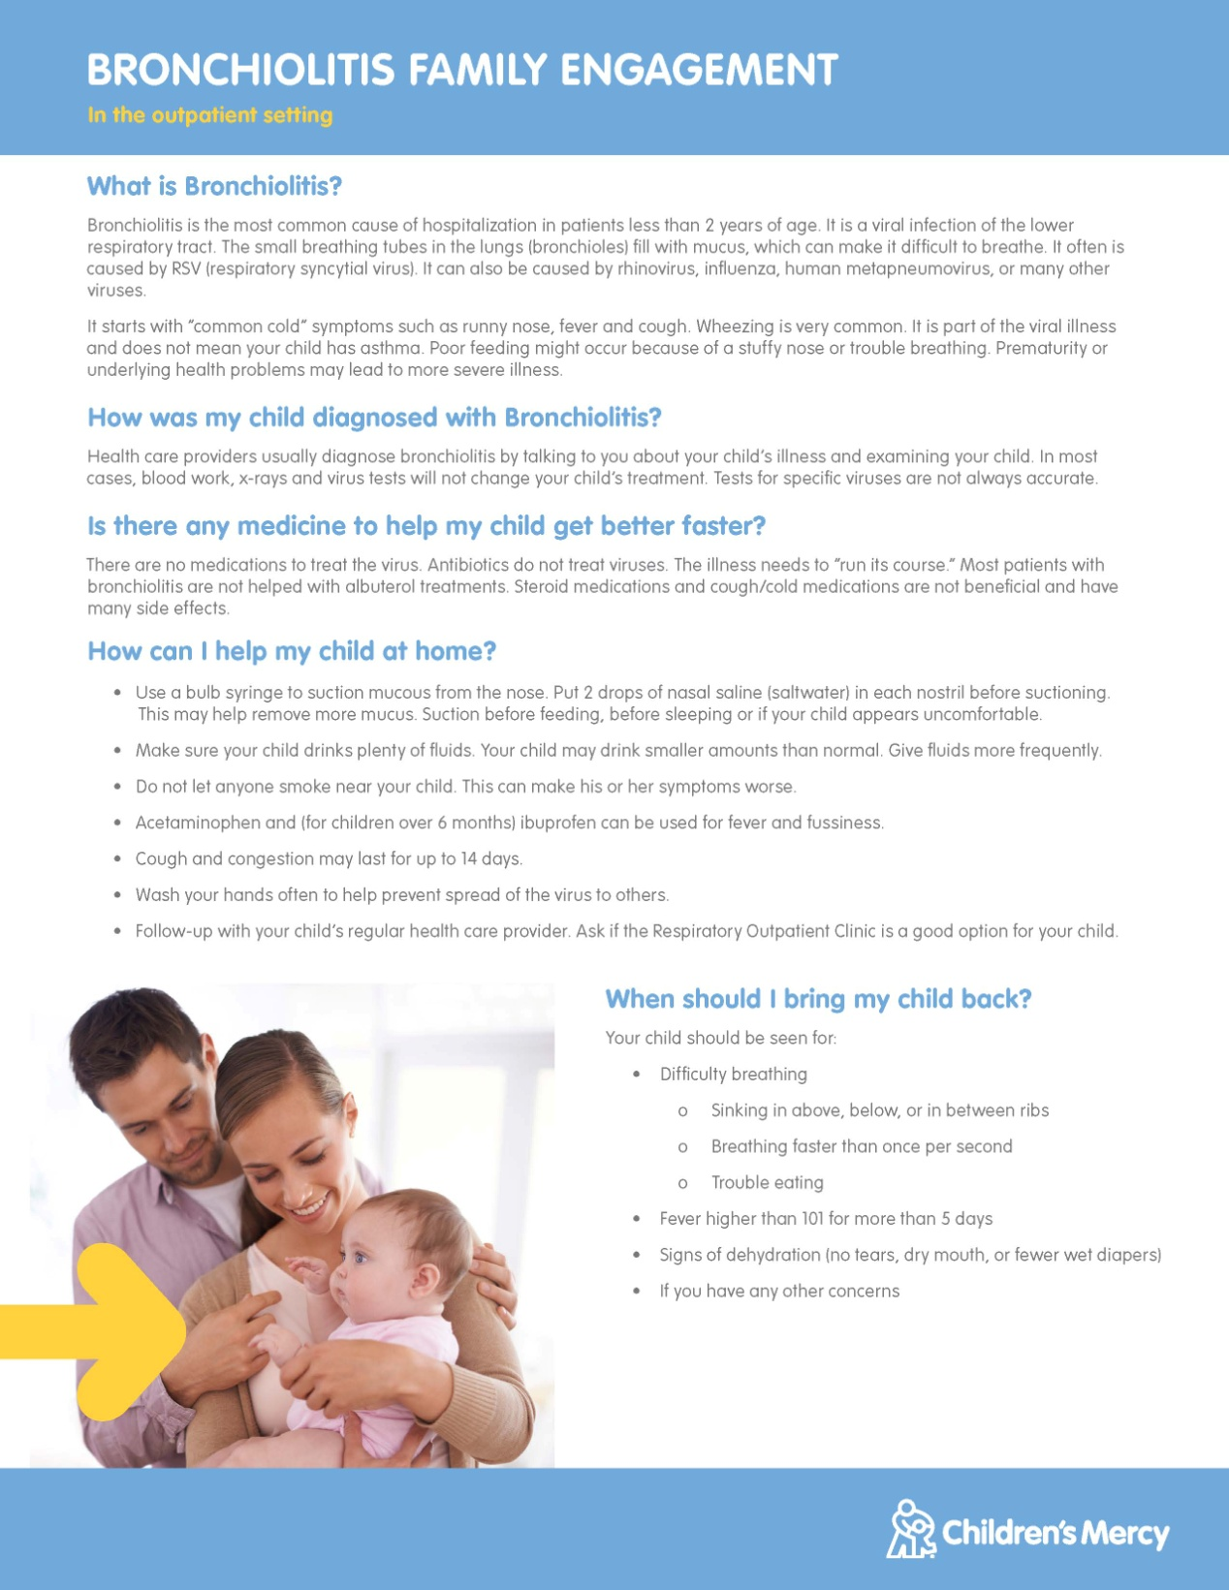
Do: Interventions
2016-2017
Updated Bronchiolitis CPG
  Compliant with 2014 Guidelines
  Added “tangible” options
Updated ED/UC & inpatient bronchiolitis power plans
Multidisciplinary education (RT, nursing, residents, ED/UCC providers, hospitalist)
Bronchiolitis Family Education
Notes:
One of the reasons providers don’t use the Bronchiolitis Order Set or PowerPlan is because it is a “do nothing” order set, so we tried to add “tangible” options: the family education, bulb syringe, and the Respiratory Outpatient Clinic which I will discuss in more detail later in this talk
During multi disc education – emphasized suctioning prior to ordering test or medication

Slide 31
Do: Interventions
2017-2018
Engaged with CM Primary Clinics
Engaged with CM Nurse Advice Line
Multidisciplinary education (RT, nursing, residents, ED/UCC providers, hospitalist)
Respiratory Outpatient Clinic at BV UC
Removed Rapid RSV from standing order
Improved dissemination of data
  Bronchiolitis Dashboard
Notes:
Engaging across divisions helped form relationships and understanding…we are admitting patients and the hospitalists were discharging them…better understanding of why we were admitting and why the hospitalists were discharging. We reached out to the Primary Clinics and Nurse line

Slide 32
Study: Data Analysis
Improved Compliance with CPG
  Baseline: 35%
  2016-2017: 53%
  2017-2018: 57%
Decreased albuterol use
  23% → 8%
Decreased rapid RSV
  29% → 9%
Increased antibiotics
  14%→ 22%
Decreased direct costs
  $276 → $224
Admits
  6.5% → 5.7%
LOS
  1.59 hr → 1.63 hr

Slide 33
Act: Next Steps
Target Antibiotic Use:
  DART modules from Seattle Children’s Hospital
    http://www.seattlechildrens.org/research/child-health-behavior-and-development/mangione-smith-lab/dart-learning-modules/
Respiratory Outpatient Clinics at all 3 Urgent Care Site for 2018-2019 Bronchiolitis Season

Slide 34
Respiratory Outpatient Clinic (ROC)
Started in November 2014
  1 location, 24/7 during peak respiratory season
  Staffed exclusively by RT in close proximity to ED
  Referral required (CM and outside providers)
    Diagnosis must be bronchiolitis
    Good for 7 days from date of referral
  Specific exclusion criteria
    No one over 24 months, chronic lung, CHD, or febrile infants < 8 weeks or concomitant diagnosis of pneumonia, pertussis, asthma flare

Slide 35
ROC
2nd Location opened Dec 2017 in Urgent Care
  Available off peak hours → operating hours
  Internal referral → Open referral

Slide 36
Respiratory Outpatient Clinic
Expanded to all 3 UC sites for 2018-2019 bronchiolitis season
  Available during operating hours
  Open referral
  Online reservation required (45 min appt)

Slide 37
Respiratory Outpatient Clinic
Pre-Intervention Score
Intervention – NOT ALWAYS SUCTIONING!
  Bronchiolitis Education
  Bulb syringe, NA or NP suctioning
Post-Intervention Score
Referral to ED/UCC or PCP if indicated

Slide 38
Children’s Hospital of Wisconsin Urgent Care
7 Wisconsin Locations
  6 in the greater Milwaukee area
    Weeknights 5-10pm
    Weekends 11am-5pm
  Kenosha Site
    9 am to 9 pm 7 days a week
Provider staffed by pediatricians and APPs
Ancillary staffed by RNs and MAs

Slide 39
CUC Bronchiolitis Data
 | 2014 | 2015 | 2016 | 2017 | 2018 | 2019
Children’s UC Total Visits | 22,495 | 23,035 | 29,314 | 36,807 | 43,067 | 27,118
Children’s Urgent Care Bronchiolitis Visits | 158 | 190 | 470 | 511 | 684 | 454
Percentage of Total Visits for Bronchiolitis | 0.7% | 0.8% | 1.6% | 1.4% | 1.6% | 1.7%
Bronchiolitis Throughput- Check in to AVS | 91.9 minutes | 71.2 minutes | 70.2 minutes | 66.1 minutes | 64.7 minutes | 56.2 minutes
Notes:
2019 Data is as of 6/24/19
We changed to a different dashboard to track bronchiolitis in 2016, so the bronchiolitis volumes might be underreported in 2014 and 2015. (When using the original dashboard for 2016 on, the bronchiolitis numbers are lower)

Slide 40
CUC Bronchiolitis Tools
2015
  Bronchiolitis treatment guideline created
2016
  Initial bronchiolitis provider note templates and discharge instructions developed
2018
  Bronchiolitis Quality Dashboard Completed (pulling data only from 2016 forward)
  Goal setting around UC quality measures (asthma, bronchiolitis, croup, and UTI) strongly encouraged among providers

Slide 41
CUC Bronchiolitis Treatment Guideline
Goal: Standard Treatment Guideline for Acute Bronchiolitis across all Children’s Urgent Care sites
Key Principles:
  Accurately risk-stratify patients based on history and physical exam
  Limit interventions such as imaging, testing, nebulized albuterol, and antibiotics
  Encourage use of NP suction
  Educate families on the natural course of illness to improve patient satisfaction
Additional Opportunity:
  Align treatment guideline with national recommendations and standards of care across CHW Primary Care, Children’s Specialty Group, CHW ER, and the CHW Hospitalists.

Slide 42
CUC Bronchiolitis Treatment Guideline
Guideline begins with the definition, etiology, and differential diagnosis of the condition, including the pathophysiology behind the symptoms:
  Acute inﬂammation
  Edema and necrosis of epithelial cells lining small airways
  Increased mucus production
  Obstruction of the small airways causing air trapping and atelectasis, often causing symptoms of wheezing.
CUC Bronchiolitis Treatment Guideline was predominantly based off of the 2014 AAP Bronchiolitis Guidelines
Notes:
NOTE: Wheezing symptoms present in bronchiolitis are not usually the result of bronchospasm!

Slide 43
2014 AAP Bronchiolitis Guidelines
Clinical Diagnosis
  Should be made on basis of the H&P examination. (Strong recommendation)
  Clinicians should assess for presence of risk factors for severe disease. (Moderate recommendation).
  Radiograph or laboratory studies should not be routinely obtained (Moderate recommendation)
  Albuterol: clinicians should not administer albuterol to infants and children with a diagnosis of bronchiolitis. (Strong Recommendation)
Notes:
In 1965 Drs. Wright and Beem provided advice in Pediatrics on bronchiolitis and although this was 50 years ago there is little changes in how we should manage these kids. The sound advice given 50 years ago has been greatly ignored and we need to re-think how we manage this population. Recall bronchiolitis is self limiting and will improve despite our involvement.

Slide 44
2014 AAP Bronchiolitis Guidelines
Epinephrine: clinicians should not administer epinephrine to infants and children with a diagnosis of bronchiolitis (Strong Recommendation)
Nebulized hypertonic saline: clinicians should not administer to infants and children with a diagnosis of bronchiolitis in outpatient setting (Moderate Recommendation)
Corticosteroids: clinicians should not administer systemic corticosteroids to infants with a diagnosis of bronchiolitis. (Strong Recommendation)
Oxygen: clinicians may choose to not administer supplemental oxygen for saturations > 90% to infants and children with bronchiolitis. (Weak Recommendations due to low level reasoning and little evidence)

Slide 45
2014 AAP Bronchiolitis Guidelines
Antibiotics: Clinicians should not administer antibacterial medications to infants and children with a diagnosis of bronchiolitis unless there is a concomitant bacterial infection. (Strong Recommendation)
NG or IV fluids: clinician should administer fluids to an infant who cannot maintain hydration orally. (Strong Recommendation)
Hand washing: Clinicians should disinfect hands before and after direct contact with patient with a diagnosis of bronchiolitis (Strong Recommendation)
Imaging: clinicians should choose not to obtain a CXR to confirm the diagnosis of bronchiolitis. (Strong Recommendation)

Slide 46
CUC Bronchiolitis Treatment Guideline
Risk factors for severe disease:
Risk factors for apnea or respiratory failure:
Prematurity (<37 weeks)
Age less than 12 weeks
Chronic pulmonary disease (esp BPD)
Congenital and anatomic defects of the airways
Congenital heart disease
Immunodeficiency
Neruological disease
Age less than 8 weeks
Previous apnea during this illness
Respiratory rate at presentation <30 or >70 breaths per minute
Room air sat <90% at presentation

Slide 47
Indications for Transfer (ED vs Direct Admit)
Signs and Symptoms that warrant transfer to a higher level of care:
  Significant respiratory effort despite supportive care in clinic:
    Nasal flaring
    Moderate to severe retractions or abdominal breathing
    Grunting
  Respiratory rate: greater than 70 or less than 30
  Dyspnea, Cyanosis or history of Apnea at home
  Hypoxemia (SpO2 < 90%)
  Symptoms or signs of dehydration or not tolerating oral feeds at home
Transfer to EDTC:
  Patients who are clinically unstable and are at risk for respiratory decompensation
  Patients in whom the diagnosis or need for admission is uncertain
  Febrile neonates requiring a septic work-up.
Direct Admit to CHW Hospital:
  Patients who clearly need admission but who are clinically stable.

Slide 48
Bronchiolitis Inpatient Admission Criteria Tables
Hospital Name | Requiring O2 to maintain SpO2 | Poor oral intake | Tachypnea/ Respiratory Distress | Apnea | Ill appearance | Suctioning Needs | Unsafe to send home/poor follow-up
Children’s Hospital of Colorado | X (>0.5 L) | X | X (tachypnea for age) | X (witnessed) | X
Texas Children’s Hospital | X | X | X |  |  | X | X
The Children’s Hospital at Montefiore | X | X (relative) | X (RR > 70 is absolute; RR > 60 is relative) | X
Children’s Hospital of Philadelphia | X | X | X |  |  |  | X
Seattle Children’s | X | X | X | X |  |  | X
UNC Peds – ED only | X (if on HFNC admit to PICU) | X | X (RR > 60-70) |  | X (at risk for progression) |  | X
The Hospital for Sick Children | X | X | X |  | X (“inappropriate lethargy” |  | X
Cardinal Glennon Children’s Hospital | X | X | X |  |  |  | X
Dayton Children’s | X | X | X | X
NICE Guidelines | X | X (50-70% of usual volume) | X | X (observed or reported) |  |  | X
Credit for Table: Brittany Player (Hospitalist) and Lia Bradley (EDTC, pathways coordinator)
Notes:
Although many of these criteria are similar, there is no universal guideline nationally.

Slide 49
CUC Bronchiolitis Treatment Guideline
Who should be sent by ambulance?
All patients in significant respiratory distress or needing oxygen support to maintain O2 sats over 90% should be sent by ambulance.
Any patient with concern for impending respiratory failure.
Infants under 8 weeks old (56 days) with a fever (38.0 o C or higher) should be sent for a sepsis evaluation, but can go by car if well-appearing and not fitting above criteria.
Infants needing admission due to not tolerating PO feeds but with stable pulse ox can be transported by car if no significant respiratory distress.

Slide 50
CUC Bronchiolitis Treatment Guideline
Stresses importance of caregiver education:
  Supportive care measures to help them care for their child at home
  Signs of respiratory distress and dehydration to watch for
  The natural course of the illness (esp. the prolonged nature of the symptoms)
  The importance of regular hand-washing while caring for a sick child
  Dangers of second hand smoke exposure

Slide 51
CUC Bronchiolitis Transfer Data
 | 2016 | 2017 | 2018 | 2019
% Transfer to CHW (ER or admission) | 7% | 10% | 11% | 10%
% Transfers by ambulance | 90% | 19% | 20% | 17.2%
Percent of total bronchiolitis patients admitted to hospital | 3.3% | 5.2% | 4.9% | 4.4%
% Treated with Albuterol in UC | 43.8% | 45.2% | 38.3% | 18.9%
Notes:
These will be important numbers to track over the next few years as we follow our bronchiolitis quality data. Our use of albuterol in clinic for bronchiolitis has

Slide 52
Bronchiolitis Quality Metrics:
Children’s Urgent Care
Operations dashboard measures for bronchiolitis:
  Visit volumes
  Throughput times
  Additional care encounters
    Presentations to UC, ER, and Admission w/in 48 hours of the UC visit
    Disposition (transfers to ER in car vs ambulance, transfers to direct admit in car vs ambulance)
  POCT performed
Current UC Bronchiolitis Quality Dashboard Measures:
  Use of Albuterol
  Use of NP Suction
  CXR Orders
  Prescription of Antibiotics

Slide 53
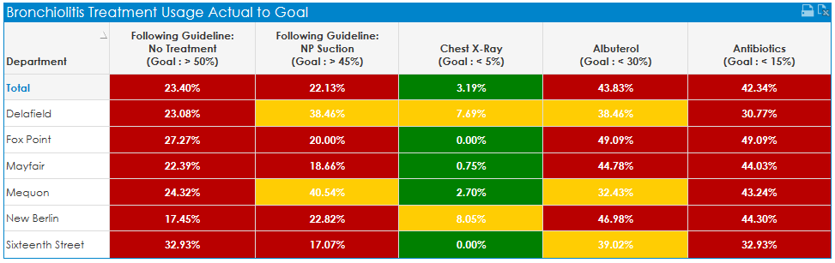
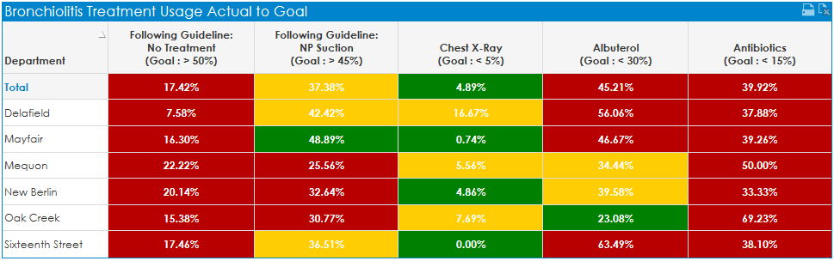
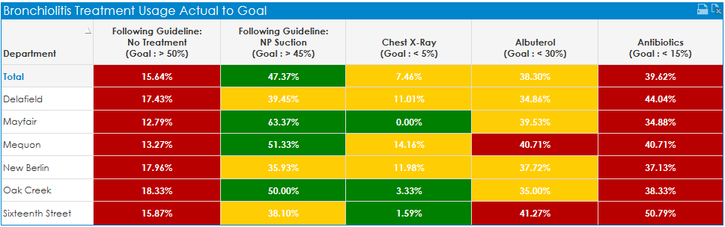
2016
% following guideline: 32.6%
2017
% following guideline: 29.2%
2018
% following guideline: 31.6%
Notes:
This is one view of our quality dashboard on bronchiolitis, looking at % using NP suction, CXR, Albuterol, and Antibiotics

Slide 54
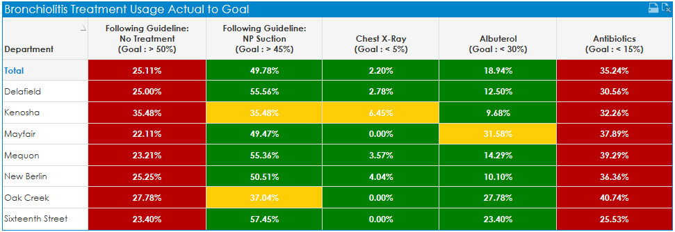
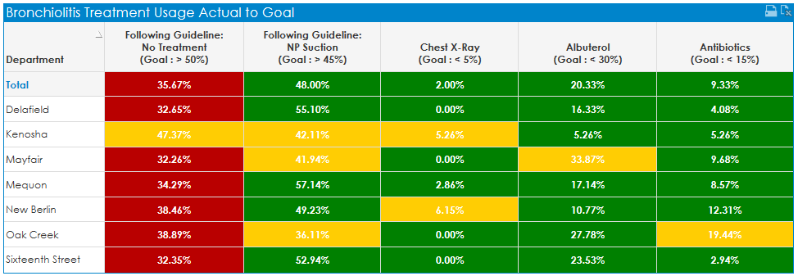
2019
% following guideline: 50.2%
2019
Visits with ear infection dx removed
% following guideline: 70.3%
(Out of 454 visits for bronchiolitis, 154 visits also had a dx of ear infection)
Notes:
2016 no ear infection dx: 32.6% increases to 50%
2017 no ear infection dx: 29.2% increases to 43%
2018 no ear infection dx: 31.6% increases to 46.5%
Having a way to measure use of the guideline and holding individuals accountable for their own data has made a large difference in our groups overall performance on these measures! But there is still room for improvement!

Slide 55
Adherence to Bronchiolitis Guidelines
CHW Urgent Care
In 2018, of the 684 patients seen in Urgent Care for bronchiolitis the adherence to the AAP bronchiolitis guidelines was 31.6%.
The most common reasons for failure to adhere to treatment was antibiotic prescriptions and treatment with nebulized albuterol.
When correcting for visits where an otitis media was diagnosed, compliance with the bronchiolitis guideline from an antibiotic prescription perspective improved significantly.
The most common reason reported for lack of adherence (40%) was a lack of knowledge about the bronchiolitis guideline and not knowing where to find it.
Notes:
Let's take a closer look at adherence to guidelines. Most physicians interviewed in a 2014 study on adherence to the national guidelines cited physicians found the following barriers to adherence: co-morbid diseases, lack of familiarity with guidelines, perceived pressures that the parents wanted an intervention such as an antibiotic, fear of upsetting the parents and losing them as patients, the perceived severity of the disease state, and readability of the guidelines itself.
The number one concern in the CHW urgent care was familiarity and location of the guidelines.

Slide 56
QI Project
Although I have been an FNP since 1997 and have ~ 10 years of experience in the emergency room and urgent care at CHW, I am enrolled at Concordia University of Wisconsin in the Doctorate of Nursing Practice. This program is preparing me for a role as a nurse leader. As part of this project I am taking on a QI project.
As can be seen from the differences in management and criteria for admission there is variation across the country in management. I would like to reduce the variation in management of bronchiolitis locally. Ideally, I see primary care providers, urgent care, and emergency room providers speaking the same language with consistent management.
The use of assessment tools may drive reduction in variation and identify severity of illness.
Over the next 6 months my QI project will evaluate the adherence to the AAP guidelines for patients less than 2 years old presenting to CHW urgent care with a primary diagnosis of bronchiolitis. I will look at the reduction of the use of albuterol, antibiotics, and CXR in management.

Slide 57
Resources
Bronchiolitis Guideline and Provider Note Template
Bronchiolitis Report of Children’s Urgent Care
Bronchiolitis Peds in Review
AAP EQUIP Module Bronchiolitis - CME MOC 4 credit
Winter QI Project: recruiting 5-10 providers interested in participating in a pilot to decrease albuterol utilization with an objective measurement tool

Slide 58
References:
Duarte-Dorado, D. M., Madero-Orostegui, D. S., Rodriguez-Martinez, C. E., and Nino, G. (2013). Validation of a scale to assess the severity of bronchiolitis in a population of hospitalized infants. Journal of Asthma. 50(10). 1056-1061. doi: 10.3109/02770903.2013.834504.
McCulloh, R. J., Smitherman, S.E., Koehn, K. L., and Alverson, B. K. (2014). Assessing the impact of national guidelines on the management of children hospitalized for acute bronchiolitis. Pediatric Pulmonology. 49, 688-694.
Quinonez, R. A., and Schroeder, A. R. (2015). Safely doing less and the new AAP bronchiolitis guidelines. Journal of American Academy of Pediatrics. 135. 793-795. doi:10.1542/peds.2014-3703.
Ralston, S. L., Lieberthal, A. S., Meissner, H. C., Alverson, B. K., Baley, j. E., Gadomski, A. M., Johnson, d. W., Light, M. J., Maraqa, N. F., Mendonca, E. A., Phelan, K. j., Zorc, J. J., Stanko-Lopp, D., Brown, M.A., Nathanson, I., Rosenblum, E., Sayles III S., and Hernandez-Cancio, S.(2014). Clinical practice guidelines: The diagnosis, management, and prevention of bronchiolitis. Journal of American Academy of Pediatrics, 134, 1474-1502. doi: 10.1542/peds.2014-2742
Subcommittee of Diagnosis and Management of Bronchiolitis. Diagnosis and management of bronchiolitis. Pediatrics, 118. 17741793.

