Slide 1
The culture of exceptional care
August 15, 2019
Nathan Sheets- Leadership Development Program Manager
Notes:
At the end of the session, participants will:
Explain the why values and culture are critical to organizational success.
Articulate the importance of alignment and integration

Slide 2
Learning Objectives:
At the end of this session, participants will be able to…
Explain the critical role that a “common” language (values, culture concepts) have on building organization and team effectiveness.
Describe the importance of alignment and integration of culture shaping inputs.
List culture concepts that influences employee engagement and patient experience.

Slide 3
Our Vision:
Wisconsin kids will be the healthiest in the nation
Our Mission:
Our mission (CARE) is the work we do to achieve our vision.
Caregiving
Advocacy
Research
Education

Slide 4
Our Values
Notes:
Benefits of Values:
Help in the decision making process-
Provide identity to our organization to patients/families, referring providers, internal providers and employees
Foundation of our culture- Guides our behaviors
Attracts and retains talent

Slide 5
At Our Best
Unfreezing Session-
8-hour instructor-led-training focusing on culture concepts and emotional intelligence.
Striving to have 100% of CHW employees (including providers) and CSG providers attend.
Reinforcement
Monthly tools
Series of self directed resources that are aligned to the value of the month.
Supports leaders and employees in leveraging culture and values to build high performing teams.
At Our Best Live!
Quarterly informal discussion sessions featuring senior leaders and audience members exploring ways they bring values an culture to life in their everyday work.

Slide 6
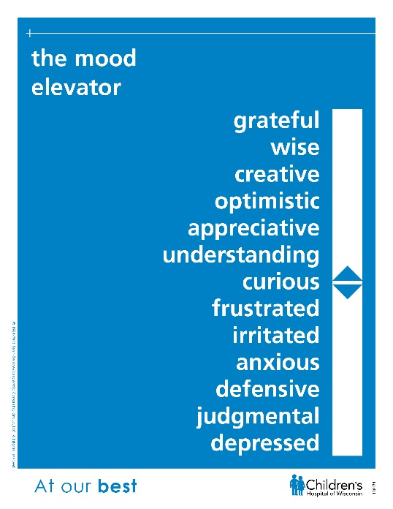
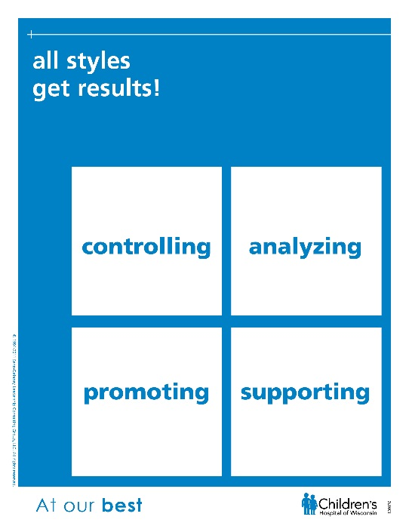
Culture Concepts
Shared language for talking about expected behaviors
Concepts support our values
Increases internal awareness and appreciation for the differences in others.

Slide 7
Children’s At Our Best journey
2015
Five new At Our Best facilitators trained
Value of the month tools introduced on Children’s Connect
At Our Best LIVE! premieres in September, 2015
2015: 35 sessions, 788 participants
2011-2012
2017
Six new At Our Best facilitators trained, bringing total of 17
Organizational culture assessment; updated guiding behaviors
2017: 51 sessions, 1420 participants
Began consulting with national firm Senn Delaney
Children’s values established
At Our Best culture work branded
2012: 2 total sessions, 303 participants
2014
Established values logos
Dedicated training space at Woodlake secured
2014: 38 sessions, 1179 participants
2013
2016
2018
Children’s first At Our Best facilitators trained
Roll-out of 2 day Unfreezing sessions to employees
Participants selected at VP level
2013: 22 sessions, 656 participants
Children’s performance philosophy updated to include WHAT is done at work, HOW it is done and CONTINUOUS LEARNING
2016: 36 sessions, 1107 participants
Unfreezing sessions move from 1.5 days to 1 day.
Established partnership with Gallup for annual engagement surveys
78% of employees and 89% providers have attended At Our Best session
2018: 58 Sessions, 1516 participants
2011-2012 | 2013 | 2014 | 2015 | 2016 | 2017 | 2018

Slide 8
Integration and Alignment
Language of Caring
At Our Best Culture Concepts
Best and Safest Care
Trauma Informed Care
Children’s Values and Guiding Behaviors
Inclusion Diversity & Equity
Child and Family Experience

Slide 9
Integration and Alignment
Children’s Values and Guiding Behaviors
At Our Best Culture Concepts
Best and Safest Care
Language of Caring
Trauma Informed Care
Inclusion Diversity & Equity
Child and Family Experience

Slide 10
By the Numbers
Number of Unfreezing Sessions in 2019 40
Total AOB compliance 86%
Total Provider compliance 92%
Unfreezing Session Registration Capacity 103%
Number of page culture page hits 13,046 Number of culture page downloads 2,049
Average number of AOB LIVE! views 300

Slide 11
Successes
CEO and the system strategy team are visible champions of culture shaping
17 internal facilitators for the At Our Best Unfreezing Program
Over 150 culture champions across the system
Achieved SE Wisconsin Best Place to Work award for 9 straight years
Recognized and felt as a point of distinction from external stakeholders (i.e. Joint Commission)
84th percentile in patient satisfaction among pediatric urgent cares in the nation.

Slide 12
Challenges
Variability in reinforcement tactics
Third shift and geographically dispersed colleagues can’t access unfreezing session.
Competing priorities
Overcoming the “corporate” feel.

Slide 13
Impacts
Connection to Provider Engagement Urgent Care (CHW)
I feel a strong connection to Children’s Culture 4.15 (4.01)
At Children's, we are becoming more collegial and collaborative. 4.12 (3.98)
Children's cares about my overall well-being. 3.81 (3.66)
Language of Caring
Providers who have experienced LoC have seen a 4.92% increase in their patient experience scores!
Urgent care experienced the first Communicating Empathy module.
Talley sheet initiative is currently ongoing.
Week 3 of the initiative- 103 instances of observable Heart-Head-Heart interactions.
Connection to Patient Family Experience
Communicate openly and honestly
What matters most
Involved children and families in decisions that impact
Delivering integrated care
Primary Care
Urgent Care
Specialty Care
Acute Care/Hospital
Notes:
Urgent Care was the first group to receive communicating empathy-
July 9th and 10th
Facilitated by their own peers
90 minutes
What is empathy
Heart head heart
Created tally sheets of when skill is utilized
Totaling tallies

Slide 14
“The patient experience can’t exceed the employee experience.”
- Peggy Troy, CEO CHW

Slide 15
“People will forget what you said, people will forget what you did, but people will never forget how you made them feel.
- Maya Angelou

Slide 16
QUESTIONS?

Slide 17
Quiz
What is one At Our Best concept that can elevate the experience of patients and colleagues?
What is one tactic that CHW uses to reinforce our culture?
What is one positive impact that an aligned culture has on child and family experience?

