Slide 1
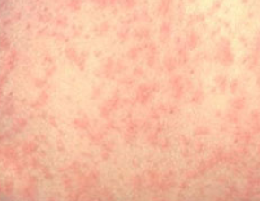
I, SPY MEASLES!
For the Urgent Care Provider
Dr. Hina Zaidi, MD (Assistant Professor, Pediatric Infectious Diseases)
Dr. Jennifer Johnson MD, FAAP (Director, Division of Urgent Care)
Children’s Mercy Kansas City
September 5th, 2019

Slide 2
Learning Objectives
Understand current risk factors for measles infection in the United States.
Know history and exam findings concerning for measles and initial approach to caring for a suspected measles patient in Urgent Care.
Know the pearls to ensure readiness for measles outbreak affecting your Urgent Care Center.

Slide 3
Content Flow
Description of Pathogen & Pathogenesis
Epidemiology
Risk Factors
Outbreaks
Clinical presentation & Complications
Lab diagnosis
Management
Preventive Measures

Slide 4
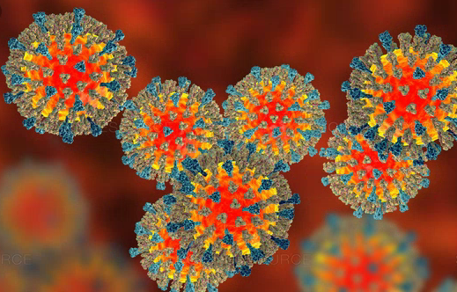
THE PATHOGEN
Measles caused by Rubeola virus, a Morbillivirus of the Paramyxoviridae family
Enveloped RNA virus with 1 serotype
Humans are only natural hosts
(no animal reservoir)
Vaccine preventable disease

Slide 5
MEASLES PATHOGENESIS
Transmitted person to person via respiratory route
Breathing, coughing, sneezing
Direct contact with respiratory secretions
Airborne contact with large respiratory droplets (droplets infective for ~2 hours)
Natural infection results in lifelong immunity
Highly contagious!
ATTACK RATE IN A SUSCEPTIBLE PERSON IS 90%

Slide 8
Content Flow
Description of Pathogen & Pathogenesis
Epidemiology
Risk Factors
Outbreaks
Clinical presentation & Complications
Lab diagnosis
Management
Preventive Measures

Slide 9
EPIDEMIOLOGY
Who? (Age)
Pre vaccine era, mostly preschool and school age children
Post vaccine era, mostly 6-12 months old
What? (Incidence)
One of the leading causes of death worldwide in nonimmunized children <5 years old due to pneumonia, encephalitis, or dehydration
Globally, pre-vaccine era: > 2 million deaths annually
Post vaccine era, > 100,000 preventable deaths annually
Incidence likely underestimated (under reporting)
Where? (Location)
Resource-limited countries from low vaccination rates
Resource-rich countries from outbreaks in pockets of suboptimal vaccination exposed to imported measles virus from travelers
When? (Season)
In temperate climates, peak incidence in late winter through early spring

Slide 10
Content Flow
Description of Pathogen & Pathogenesis
Epidemiology
Risk Factors
Outbreaks
Clinical presentation & Complications
Lab diagnosis
Management
Preventive Measures

Slide 11
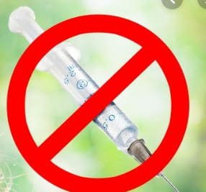
RISK FACTORS FOR MEASLES
1. Know patient exposure history
Any international travels or contact with sick individual who recently traveled to endemic area
Attendance in large gatherings with possibility of recent travelers
2. Know patient status of immunity
Completely unvaccinated due to young age, medical contraindication to receive vaccine, or other reasons
Not fully vaccinated with 2 dose series
INTERNATIONAL IMPORTATION RUBEOLA VIRUS INTO USA
(travelers as vectors)
SPREAD TO THE VULNERABLE
→ NON-IMMUNIZED OR UNDER-IMMUNIZED PEOPLE

Slide 12
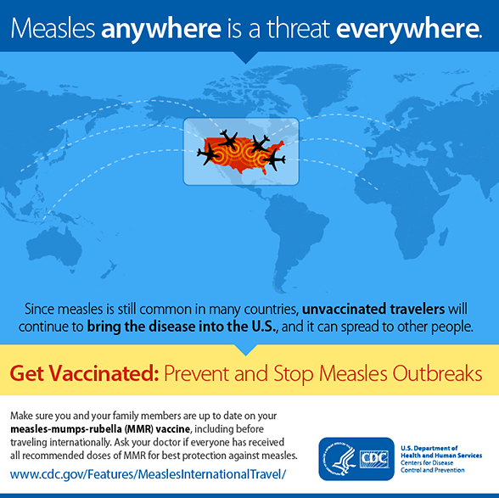
BEST PREVENTATIVE MEASURE
Vaccination against Measles!
MMR is safe and effective
Mild vaccine side effects: fevers, soreness at injection site, rash
Scientific studies concluded no link of vaccine OR thimerosal to autism
BUT… vaccine hesitancy still exists
Raise awareness and increase vaccination rates

Slide 13
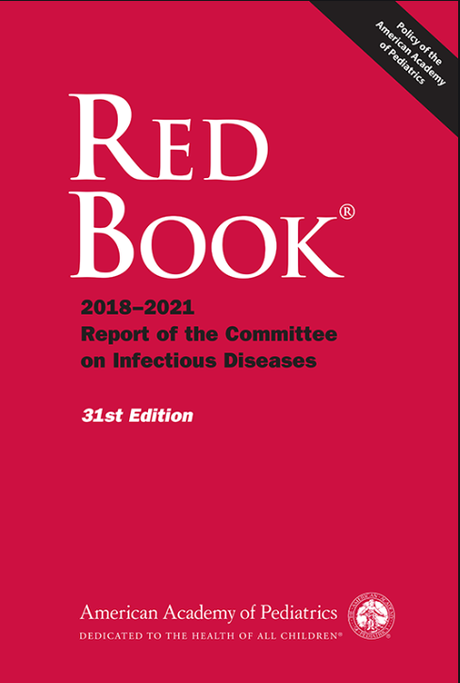
Notes:
https://redbook-solutions-aap-org.ezproxy.cmh.edu/chapter.aspx?sectionId=189639950&bookId=2205&resultClick=24

Slide 14
HISTORY OF MEASLES IN USA
Prior 1963 (pre-vaccine era): measles close to universal experience in childhood
1963: measles virus strain isolated from sick child, transformed into live vaccine and licensed in USA; >99% decreases in reported incidence
1968: attenuated measles vaccine developed (currently in use)
1989: outbreak in vaccinated school aged children → 2 dose series recommended by AAP, ACIP and AAFP
2000: measles eliminated from USA (absence of continuous disease transmission >12 months)
2008: USA outbreaks begin…
Majority imported cases affecting non immunized groups each year
Countries with their outbreaks: England, France, Germany, India, and the Philippines

Slide 15
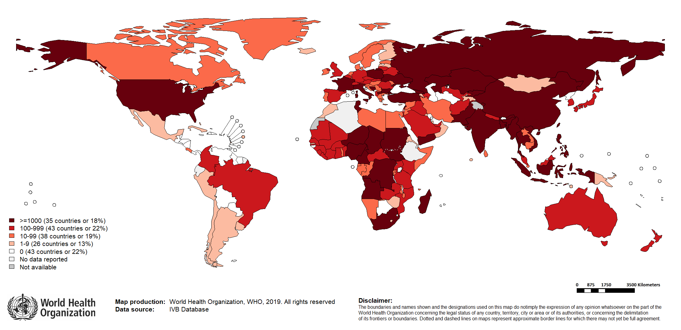
Number of Reported Measles Cases (6M period)
Top 10* | Top 10*
Country | Cases
Madagascar | 127454
Ukraine | 54246
Philippines | 36253
Nigeria | 24744
India** | 24076
Kazakhstan | 8855
DR Congo | 6451
Yemen | 5848
Myanmar | 5029
Georgia | 3874
Notes: Based on data received 2019-08 - Surveillance data from 2019-01 to 2019-06 - * Countries with highest number of cases for the period. **WHO classifies all suspected measles cases reported from India as measles clinically compatible if a specimen was not collected as per the algorithm for classification of suspected measles in the WHO VPD Surveillance Standards. Thus numbers might be different between what WHO reports and what India reports.
Notes:
-world map taken from WHO website, updated for 2019 reporting measle cases

Slide 16
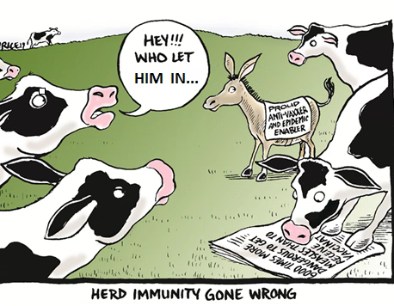
HERD IMMUNITY
MMR is effective in preventing infection to those vaccinated
Those who are unimmunized or under-immunized will be vulnerable to infection if exposed…
Population’s immunity (i.e. vaccine uptake) >95% necessary for disrupting measles transmission and
protection of unvaccinated individuals
(herd immunity)

Slide 17
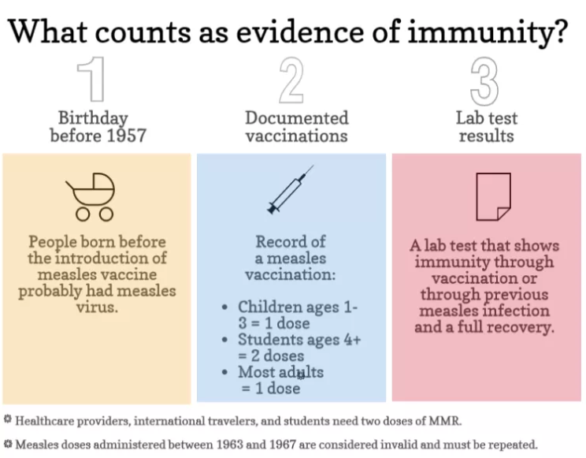
EVIDENCE OF IMMUNITY
Acceptable evidence of immunity against measles includes at least one of the following:
a) written documentation of adequate vaccination:
one or more doses of a measles-containing vaccine administered on or after the 1st birthday for preschool-age children and adults not at high risk
two doses of measles-containing vaccine for school-age children and adults at high risk (including college students, healthcare personnel, and international travelers)
b) laboratory evidence of immunity
c) laboratory confirmation of measles
d) birth before 1957

Slide 18
Content Flow
Description of Pathogen & Pathogenesis
Epidemiology
Risk Factors
Outbreaks
Clinical presentation & Complications
Lab diagnosis
Management
Preventive Measures

Slide 19
MEASLES OUTBREAKS
United States Centers for Disease Control and Prevention defines measles outbreak :
"a chain of transmission with three or more confirmed cases linked in time and space“
End of outbreak defined as:
2 consecutive incubation periods
(21 days each, total of 42 days)
without any new exposure/cases.
Notes:
-

Slide 20
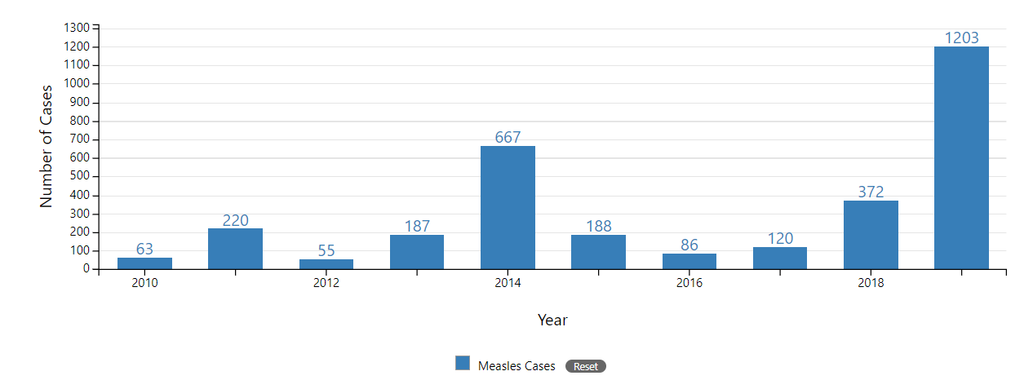
YEARLY GLANCE

Slide 21
Year | US Outbreaks | Affected people
2018 | Most cases New York State, New York City, and New Jersey | unvaccinated people in Orthodox Jewish communities, travelers from Israel (outbreak)
2017 | A 75-case outbreak in Minnesota | Somali-American community with poor vaccination coverage
2015 | 147 cases, multi-state outbreak, linked to amusement park in California | traveler who became infected overseas with measles (genotyped virus B3 identical to virus from Philippines during outbreak), then visited the amusement park while infectious
2014 | 23 measles outbreaks, mainly Ohio | unvaccinated Amish communities; associated with cases brought in from the Philippines (outbreak)
2013 | 11 outbreaks
2011 |  | Most of the cases that were brought to the U.S. from France (outbreak)

Slide 22
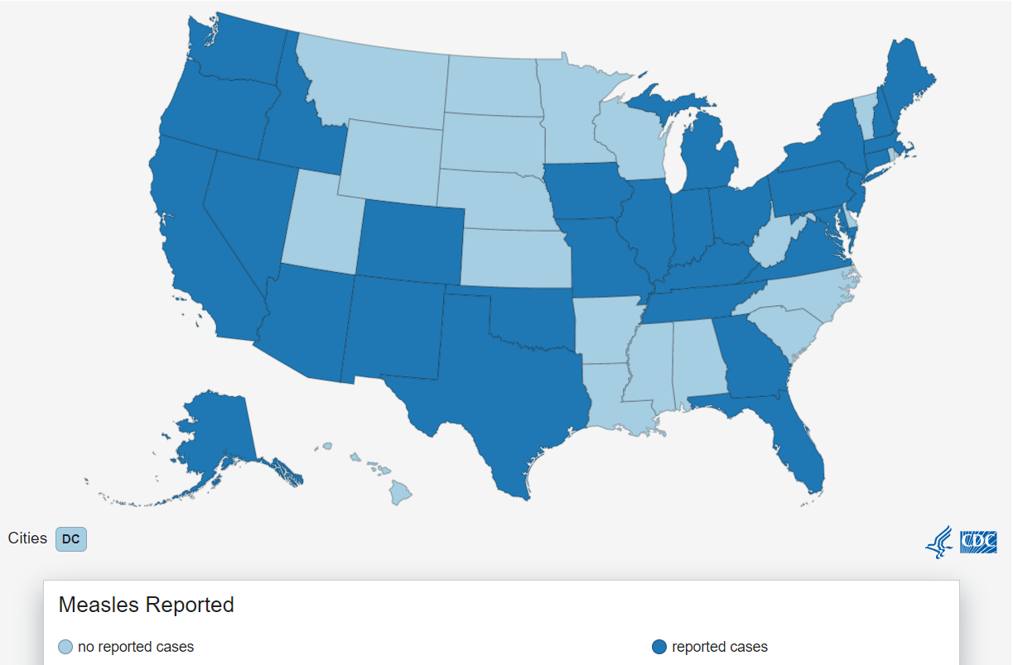
MEASLES IN 2019
As of 8/22/2019, 1,215 measles cases in 30 states
greatest no. of cases documented since 1994 (n = 963)
> 75% of the cases this year are linked to outbreaks in New York and New York City
Notes:
https://www.cdc.gov/measles/cases-outbreaks.html

Slide 23
Content Flow
Description of Pathogen & Pathogenesis
Epidemiology
Risk Factors
Outbreaks
Clinical presentation & Complications
Lab diagnosis
Management
Preventive Measures

Slide 24
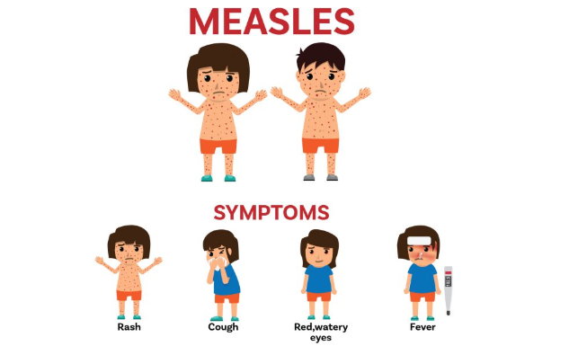
CLINICAL PRESENTATION
Incubation period ~8-12 days (range 5-21 days) from viral exposure and symptoms onset

Slide 25
CLINICAL PRESENTATION
TYPICAL MEASLES
3 C’s: Cough, Coryza, non purulent Conjunctivitis (nonspecific flu-like prodrome)
Koplik spots (pathognomonic if present) during 2-4 days prodrome
1-3 mm whitish, grayish or bluish lesions on an erythematous base
usually adjacent to the molars on buccal mucosa; hard and soft palate
Macular-papular rash head to toe progression 24-48hrs (3-4 days into illness)
Hairline→ Face→ Neck→ Truck→ Arms → Legs→ Feet
Extent of rash and confluency correlate with severity of illness
Fading occurs in same direction after several days +/- fine desquamation
HIGH FEVER (to 40 C)
MISERABLE
APPEARING
Notes:
-

Slide 26
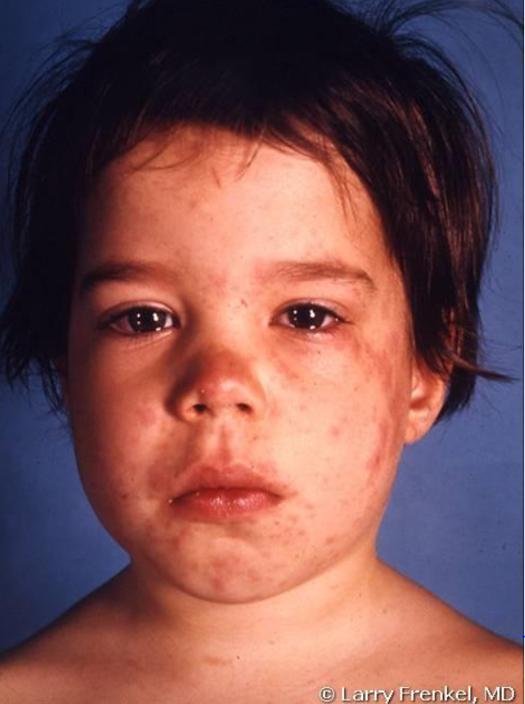
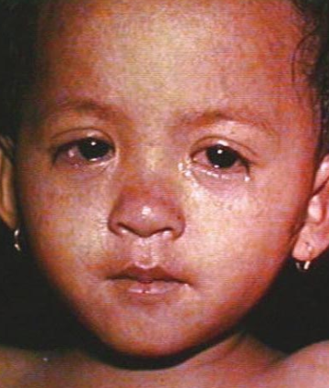
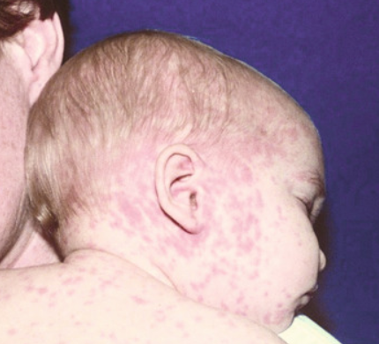
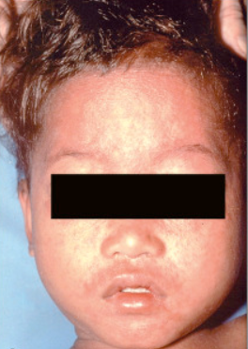
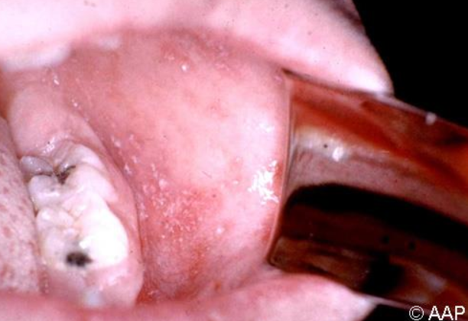
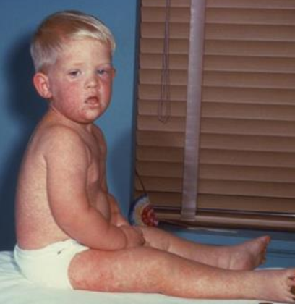
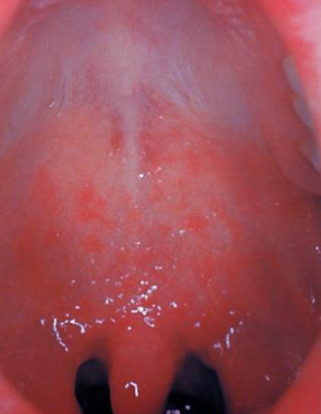
Images captured from RedBook and CDC

Slide 27
CLINICAL MANIFESTATION TIMELINE

Slide 28
CLINICAL PRESENTATION
MODIFIED MEALSES
Partial or full immunity to measles
Attenuated infection (milder infection)
Incubation period is prolonged, 14-20 days
ATYPICAL MEASLES
Immunocompromised child
May never develop rash!

Slide 29
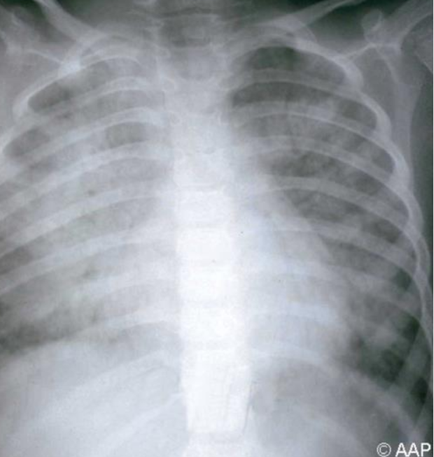
COMPLICATIONS OF MEASLES
Otitis media (MCC, 7-9%)
Diarrhea
Viral or secondary bacterial PNA
Croup and Bronchiolitis
Keratoconjunctivitis (may cause blindness)
Myocarditis/pericarditis
Myositis
Hepatitis
Encephalitis (including ADEM) → 1 per 1000 cases
Subacute sclerosing panencephalitis (SSPE), fatal degenerative disease 7-10 years post natural infection → 4-11 per 100,000 cases (rare)
Death from respiratory/neurological complications → 1-3 per 1000 cases
Younger than 5 years old
Pregnant women
Immunocompromised children (HIV, leukemia)
Severe malnutrition (vitamin A deficiency)

Slide 30
SOME DIFFERENTIALS
Rubella
Enteroviral infection
Roseola
Adenovirus
Epstein-Barr virus
Parvovirus
Streptococcal or staphylococcal infections
Rocky Mountain spotted fever
Leptospirosis
Kawasaki disease

Slide 31
Content Flow
Description of Pathogen & Pathogenesis
Epidemiology
Risk Factors
Outbreaks
Clinical presentation & Complications
Lab diagnosis
Management
Preventive Measures

Slide 32
LAB DIAGNOSIS (ACUTELY)
Any suspected case, want to confirm the diagnosis:
Measles IgM
FALSE NEGATIVES in first 72 hours after rash onset (up to 20%), may need to re-test
ABSENT or TRANSIENTLY present in immunized people s/p 1 or 2 vaccine doses
CANNOT rule out measles with negative IgM !
NOT reliable in immunocompromised
Measles real time PCR
Rapid and sensitive
Throat or nasopharyngeal swabs (urine may increase sensitivity)
HIGHEST YIELD detection within 3 days of rash onset (viral shedding); may be positive for up to 2 weeks
+
Specimens usually shipped to public health laboratory or CDC
(at direction of state health department)

Slide 33
OTHER LABS
Viral culture
Not routinely used (requires special facilities, may take up to 2 weeks to isolate)
Measles IgG comparing acute and convalescent titers (at least 10 days apart) → > 4-fold rise can diagnosis recent measles
CBC
Leukopenia, lymphopenia, thrombocytopenia
LFT
Elevated AST/ALT

Slide 34
REMINDERS
Any suspected or confirmed Measles case must be reported to your local or state health department
Nationally notifiable disease: to be reported to CDC within 24 hours
Diagnostic work up and infection control measures may vary according to location
seek guidance from your local public health authorities

Slide 35
Content Flow
Description of Pathogen & Pathogenesis
Epidemiology
Risk Factors
Outbreaks
Clinical presentation & Complications
Lab diagnosis
Management
Preventive Measures

Slide 36
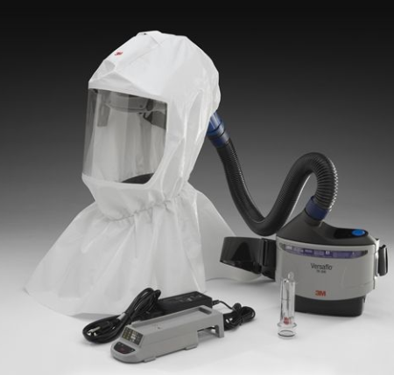
MANAGEMENT: ISOLATION
Patient is contagious ~ 4 days before until 4 days after rash onset (previously healthy) or duration of illness (immunocompromised)
Airborne and respiratory precautions (along with standard precautions)
Mask/covered in blanket and escort patient to separate waiting area or put immediately in private room, negative pressure most optimal (if none available, place in private room)
ALL caretakers are required to use
N95 respirators/PAPR’s regardless of
their vaccination status!

Slide 37
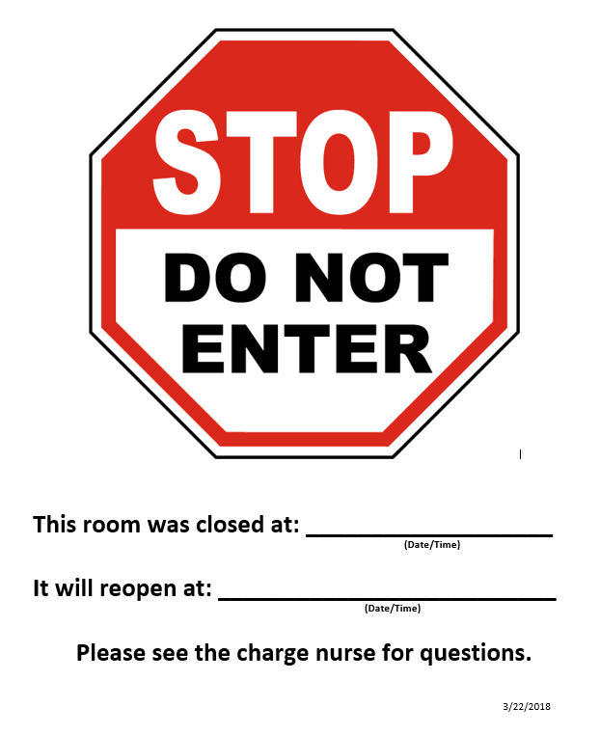
MANAGEMENT: ISOLATION
DO NOT USE patient room for 2 hours after patient left (infectious droplets can remain suspended)
Upon patient discharged home (with suspicion of measles)
ensure masked/covered in blanket
use exit route that minimizes further exposure
instruct families to keep child at home in isolation until at least 4 days after rash onset, and in accordance with local health department recommendations
FYI families health department will be contact them

Slide 38
MANAGEMENT: THE PATIENT
Treatment
No specific antiviral agents
In vitro, Measles sensitive to Ribavirin (used to treat severely immunocompromised children; not FDA licensed or approved for measles)
Supportive care
Fluids, antipyretic (avoid aspirin), antibiotics for bacterial superinfections (AOM, PNA)
Vitamin A deficiency states
Associated with severe illness and complications
WHO and CDC recommends vitamin A for ALL children with acute or severe measles (decrease morbidity and mortality)
Vitamin A supplement orally x 2 days

Slide 39
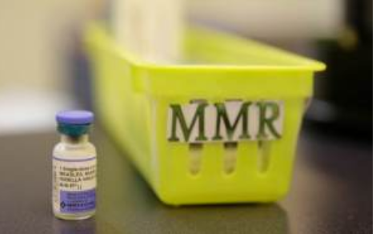
MMR VACCINE
Measles vaccine is administered with mumps and rubella as MMR
CDC recommends 2 doses of MMR
Dose 1: age 12-15 months old (93% effective)
Dose 2: age 4-6 years old (catch <5% failure rates, not a booster, 97% effective)
Minimum interval between dose 1 and dose 2 is 28 days
accelerated schedule during outbreak or if international travel and >12 months old
MMR (live attenuated viral vaccine) contraindicated for
Immunocompromised, including pregnant women
Exception with HIV patients, can receive if asymptomatic and not severely immunocompromised

Slide 40
MMR VACCINE
Earlier MMR vaccine dose for infants age 6 -11 months old recommended if
Traveling internationally before departure (regardless of destination)
Within 72 hours of exposure during outbreak, allows protection or disease modification
Early dose does not count as valid towards 2 dose series

Slide 41
POST EXPOSURE PROPHYLAXIS (PEP)
REMINDER:
Helps to keep a list of suspected exposed patient/people to a case during this visit.
Who gets Post Exposure Prophylaxis?
Those who has been exposed to only confirmed case of measles
AND
Individuals who lack evidence of immunity, such as they
Do not have 1 or more documented doses of live rubeola vaccine at age 12 months or older
Do not have laboratory evidence of immunity or laboratory evidence of disease
Were not born before 1957
OR
Those at high risk for complications

Slide 42
PEP for EXPOSED AND SUSCEPTIBLE PATIENT
MMR vaccine
May prevent or modify disease if given <72 hours since exposure
Contraindicated for those with allergic reaction (anaphylaxis), infants <6 months old, immunocompromised patient and pregnant women
Immunoglobin (IVIG or IMIG)
May prevent or modify disease if given within 6 days since exposure for immunoglobulin to be effective
Indication
Those not eligible for vaccine and high risk for disease: immunocompromised regardless vaccine status), susceptible pregnant women and infants < 12 months old
If > 72 hours since exposure (vaccine ineffective)
Dose IVIG: 400 mg/kg IV
Dose IMIG is 0.5 mL/kg (max 15 mL)

Slide 43
MANAGAMENT: HEALTH CARE PERSONNEL
Susceptible personnel (without immunization status documentation or lab evidence for immunity) advised NOT to enter suspected measles patient room
If exposed, he/she should be excluded from work starting day 5 through 21 from exposure (incubation period), regardless of their receipt of postexposure vaccine or IG!

Slide 44
URGENT CARE PEARLS
Ideal scenario: patient/family/outside provider calls ahead with concerns for measles
Allows time to prepare a plan for arrival
Be prepared: review proper use of respiratory protection wearing PAPR’s or N95
Maintain awareness: stay connected with local health department for updates on measles exposures (dates, locations etc.)
Know options: public officials may offer home visits for solely diagnostic evaluation to avoid visits to health facilities
Keep track: potential individuals exposed from case
Know your contacts in outbreak setting: Public Health Department, local hospital, Infection Control and Infectious Diseases on call (if available)

Slide 45
URGENT CARE READINESS
(Dr. Jennifer Johnson)

Slide 46
Urgent Care Center Approach
Front door signage
Travel screening at check-in
Rapid identification and isolation of patients with risk for measles
Ready supply of PPE, plan for exam room management
Consultant contact (ID, infection control, Health Department)
Specimen collection materials

Slide 48
Case Description
History
7mo male with “possible allergic reaction”
4 days high fever (102-104 at home)
On amoxicillin for ear infection dx 4 day prior in an ED
Now with rash “all over” (started on chest day prior)
Known measles in community
No daycare and no known ill contacts
UTD vaccines and older siblings UTD on vaccines

Slide 49
Case Description
Physical Exam
T 37.2 on arrival, up to 38.5 during UC visit
HR 158 R 32 O2 sat 96% (crying)
Non-toxic but ill appearing
Diffuse, erythematous, blanching macular rash
Conjunctivae erythematous but no discharge
Clear, thin nasal discharge; red throat (no Koplik spots)
Barking cough without stridor at rest, lungs clear

Slide 50
Case Description
Nurse practitioner rapidly identified clinical picture as possible measles
Child moved to negative pressure room
ID and infection control contacted
Measles PCR NP swab and blood for IgG and IgM obtained
Respiratory viral PCR specimen obtained
Decadron given with ID consultant approval
Child transferred to ED as O2 sat noted to trend down in UC; child ultimately admitted

Slide 51
Lessons Learned
Have high suspicion for measles
Ask about travel
Know your plan for infection control and PPE
Establish relationship with an ID specialist and your local Health Department
Know where/how you’ll get patients tested and treated
Identify staff at risk for measles and have plan for occupational exposure to measles

Slide 52
CHECK YOUR KNOWLEDGE
What state has the highest incidence of measles currently in the US?
T/F: If a child has received MMR prior to 12 months because of planned foreign travel, that child only needs one more MMR to complete their measles vaccination series.
T/F: Successful Urgent Care management of a patient with suspected measles consists of rapid identification of potential measles, isolation of patient, infection control measures, and coordination of care with infection and public health experts in your community.
New York
False
True

Slide 53
REFERENCES
Redbook 2018-2021: Measles. Report of the Committee on Infectious Diseases, 31st Edition. American Academy of Pediatrics. Pages 537-550
Long, Sarah. Rubeola Virus: Measles and Subacute Sclerosing Panencephalitis. Principles and Practice of Pediatric Infectious Diseases, 5th Edition. Chapter 227, pages 1169-1176. 2018
Mason et al. Measles. Nelson Textbook of Pediatrics, 21st Edition. Chapter 273, pages 1670-1676. 2020
CDC: Measles (Rubeola) https://www.cdc.gov/measles/hcp/index.html

Slide 54
Questions?
Please Contact:
Jennifer Johnson at jkjohnson@cmh.edu
Hina Zaidi at hzaidi@cmh.edu

