Slide 1
SPUC Weekly Webinar Febrile Seizures
Katie Doran, DO FAAP
Division of Urgent Care
Children's Mercy Hospital
October 17, 2019

Slide 2
Disclosures
I have no disclosures
Notes:
No disclosures pertinent to this case

Slide 3
Learning Objectives
Identify a febrile seizure and its subtypes
Understand treatment of febrile seizures specific to urgent care
Explore Evidence Based Practice guidelines for febrile seizures at Children's Mercy
Educate families on Seizure First Aid

Slide 4
Case Presentation
CC: Seizure
HPI: 2 year old female who presented actively seizing which started while she was shopping for a new fish at the pet store
+Cough and congestion for a few days, no recent fevers
History of 6 febrile seizures in the past presenting as upper and lower extremity twitching
Family is thinking about seeing Neurology as they are becoming more frequent
Notes:
Further history was provided, she has had some cough and congestion over the past couple of days.
Ultimate fever source was acute otitis media
Previous seizures have never required medication administration and have lasted a maximum of 6-7 minutes. Patient has never had prolonged seizure like this one that lasted approximately 25-27 minutes.
Neurology consulted and recommended no acute workup but did recommend Neurology outpatient follow up. Recommended patient receive rectal Diazepam to take home on discharge.

Slide 5
Febrile Seizures
Occur in about 4% of children ages 6 – 60 months in association with a febrile illness
Most common form of seizures and neurological disorder in children
30-40% will have at least one reoccurrence
General population risk of epilepsy 0.5-1%, risk in patients with febrile seizures is 1-2%.
Notes:
Reoccurrence: Predictors include, onset at <1 year, there is a family history of febrile seizures or epilepsy in a first degree relative, and daycare attendance just simply due to the fact that it increases the risk of getting a febrile illness
Febrile = 100.4 deg F or 38.0 deg C or higher

Slide 6
Febrile Seizures
Simple
Symmetric
Lasts less than 15 minutes (most <5)
Only one seizure associated with febrile illness/24 hour timeframe
Complex
Focal features during or after event
Lasts more than 15 minutes
More than 1 seizure in a 24 hour period
Notes:
Complex: Focal - unilateral shaking, starts on one side then becomes generalized or lateralized post ictal weakness
Simple febrile seizures represent those that are brief, singular, and generalized, occurring in an otherwise neurodevelopmentally healthy child, without any other infection that affects the brain, such as meningitis or abscess.

Slide 7
Febrile Seizures and Epilepsy
Dravet Syndrome (severe myoclonic epilepsy of infancy)
Often prolonged and asymmetric, progressive and starts to occur without fevers
Generalized Epilepsy with Febrile Seizures Plus (GEFS+)
Autosomal dominant syndrome
Febrile seizures can disappear by age 6, others can go on to have continued febrile seizures over age 6 and other seizure types
Notes:
There are two epilepsy syndromes that have been known to start with febrile seizures,
GEFS+ – highly variable phenotype though aut dom
SCN1a mutation in Dravet syndrome and SCN1b is common in GEFS+, these are both sodium channelopathies

Slide 8
Clinical Practice Guidelines
Simple Febrile Seizure
Complex Febrile Seizure
Notes:
Our clinical practice guidelines were developed for simple and complex febrile seizures in 2016 by a multidisciplinary team including neurology, hospital medicine, emergency medicine, urgent care, residents, pharmacists and a representative from our family centered care department. They did a comprehensive literature review and offered guidelines based on what they found. There are also AAP guidelines that were used for recommendations in these CPGs.

Slide 9
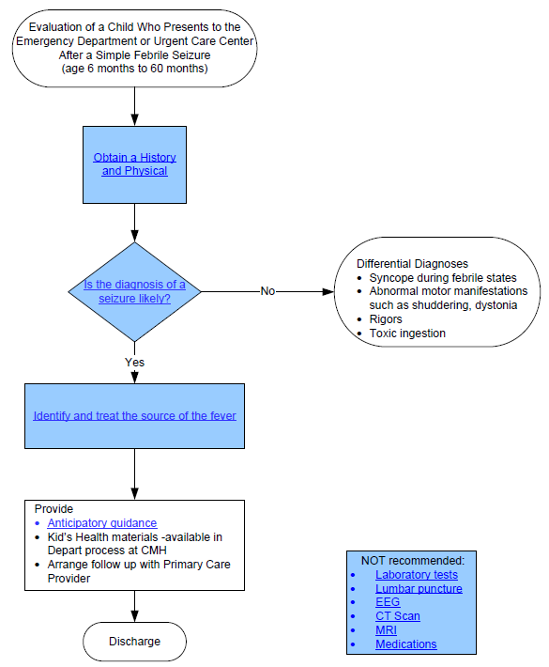
CPG Simple Febrile Seizure
Notes:
EXCLUSION CRITERIA:
Presence of: Intracranial infection
Known underlying condition, such as and inborn error of metabolism
History of afebrile seizures
Recent history of head trauma

Slide 10
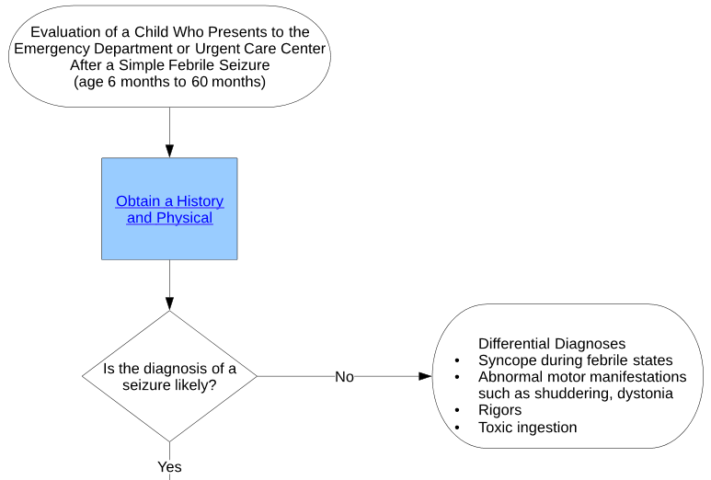
CPG Simple Febrile Seizure

Slide 11
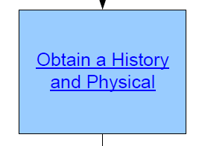
CPG Simple Febrile Seizure
Diagnostic evaluation:
History: Include characteristics of the seizure, duration, focality, recent immunizations, and if immunization status is current, family history of seizure, developmental delay, loss of consciousness.
Physical Exam: General physical exam and neurological exam, status of fontanelle (age dependent), muscle tone and or strength.
Diagnostics:
Only to diagnose the cause of the fever
Neurodiagnostic evaluation is not indicated in the routine evaluation of a simple febrile seizure aside from identifying the source of the fever.
Notes:
Your history should include everything that the parents made note of which could be nothing or multiple key identifying factors including characteristics, duration, focality, recents immz, up to date immz status, fam hx of seziure, dev delay, LOC
There is likely a genetic predisposition for febrile seizures but no inheritance pattern has been identified.

Slide 12
CPG Simple Febrile Seizure
Notes:
Next we have to evaluate whether the diagnosis of a seizure is likely. Note the differential diagnosis of seizure which includes syncope during febrile states, abnormal motor manifestations like shuddering or dystonia, rigors or potential for toxic ingestion.

Slide 13
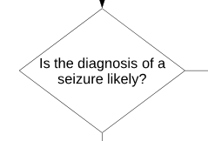
CPG Simple Febrile Seizure
Signs of a seizure:
Loss of consciousness or arrest of behavior
Abnormal eye movements: rolling up or deviated to one side
Abnormal movements of the limbs: stiffening, rhythmic jerking, loss of tone
Loss of bowel or bladder control
Drooling, teeth clenching, tongue biting
Abnormal respirations: temporary pause, grunting
Source: http://www.nlm.nih.gov/medlineplus/ency/article/003200.htm
Notes:
Most of the age group we see we can't determine whether they lost bowel or bladder control as they are diapered.

Slide 14
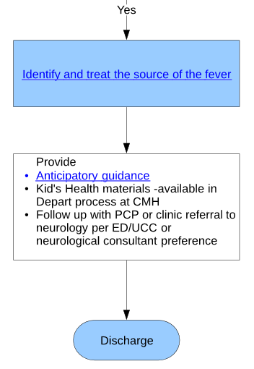
CPG Simple Febrile Seizure
Notes:
ID and treat the source of fever

Slide 15
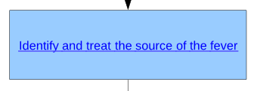
CPG Simple Febrile Seizure
Simple Febrile Seizure- the American Academy of Pediatrics Clinical Practice Guideline for the Neurodiagnostic Evaluation of the Child (Duffner et al. 2014) states that management of the simple febrile seizures should be pointed at identifying and treating the source of the fever.
Lumbar puncture (LP) is indicated in children with
Signs and symptoms of central nervous system infections, who would be off guideline.
LP is an option in children
6-12 months of age who is deficient in Hib and s pneumoniae immunization
whom immunization status is unknown
Notes:
The top priority is identifying and treating the source of fever, which if you are concerned about meningitis, then a lumbar puncture should be done, but this is also then not a simple febrile seizure and would be off guideline.

Slide 16
CPG Simple Febrile Seizure
Notes:
We will go through anticipatory guidance after going through both algorithms.
Outpatient neurology follow-up not recommended for simple febrile seizure*** They can be followed up by their PCP.

Slide 17
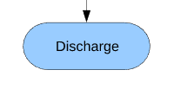
CPG Simple Febrile Seizure
Discharge Criteria:
1. The patient is back to baseline with a non-focal neurological examination
2. The likely source of the fever has been identified and treated
3. A treatment plan with appropriate follow up has been devised

Slide 18
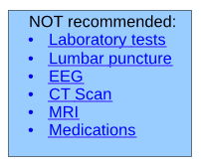
CPG Simple Febrile Seizure
Note the NOT RECOMMENDED section
Notes:
LABS: Specifically the AAP guideline (2011) states serum electrolytes, calcium, phosphorus, magnesium, blood glucose or a complete blood cell count “should not be performed in the routine evaluation of the child with a simple febrile seizure”. The recommendation is based on evidence from observational studies.
LUMBAR PUNCTURE:The AAP (Duffner 2011) Clinical Practice Guideline do not recommend the routine performance of a lumbar puncture and laboratory testing of CSF for children who present following a simple febrile seizure. When considering the source of the infection that caused the fever, if meningitis is on the differential diagnosis list or if a child is 6-12 months and undervaccinated (against Hib and Strep pneumoniae, a LP is warranted. There are four retrospective cohort studies that were referenced for this guideline that reinforce the low yield of positive results from an examination of CSF in this population.
EEG:The AAP recommendation is (Patricia K Duffner et al., 2008) that an EEG should not be performed in the child who is neurologically healthy and has had a simple febrile seizure. Two additional studies have been found since the search completed for the AAP Guideline was performed and included here. They are both are of retrospective cohort studies and do not provide additional information that supports obtaining an EEG for children after a simple febrile seizure. Both studies look at the prognostic value of obtaining an EEG and neither study separates simple from complex febrile seizures to answer this question.
CT/MRI SCAN:The CPG team agrees with the recommendation of the AAP (Patricia K Duffner et al., 2008) that states neuroimaging “should not be performed in the routine evaluation of the child with a simple febrile seizure”. Observational studies are the basis of the recommendation. Furthermore, the American College of Radiology (ACR Guideline, 2012) states there is no indication for imaging in simple febrile seizures.
MEDICATIONS:No literature was found by the CPG team for this question. The CPG team concurs with the statement made in AAP Guideline (Duffner et al. 2008) that simple febrile seizures are benign events, and not associated with neurological consequences. Therefore, seizure medications are not recommended for the child who presents after a simple febrile seizure and child should not be discharged with abortive medications.

Slide 19
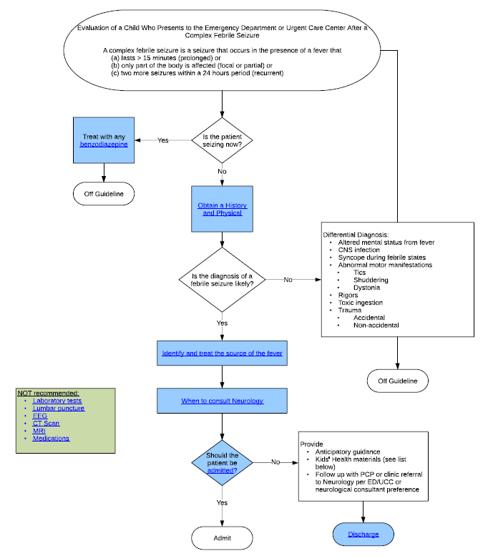
CPG Complex Febrile Seizure
Notes:
EXCLUSION CRITERIA
Presence of:
Focal neurological examination
Intracranial infection
Known underlying condition, such as an inborn error of metabolism or genetic condition
History of afebrile seizures
Recent history of head trauma

Slide 20
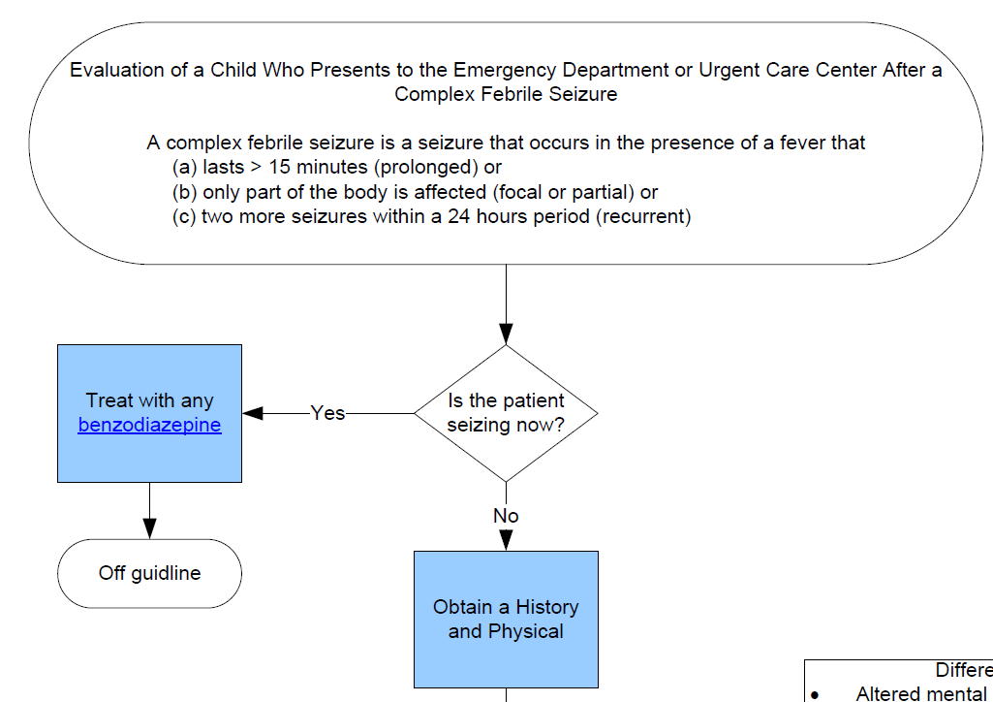
CPG Complex Febrile Seizure

Slide 21
CPG Complex Febrile Seizure
Notes:
There was no consensus on which benzo to use when the CPG was developed and the recommendation was to use ANY benzo.

Slide 22
Abortive Seizure Medications
Rectal Diazepam – Dose 0.2-0.5 mg/kg, max 20mg (see next slide)
Intravenous Diazepam – Dose 0.1-0.3 mg/kg, max 10mg
Intranasal Midazolam – Dose 0.2 mg/kg, max 10mg
Intramuscular Midazolam – Dose 0.2 mg/kg, max 6 mg
Intramuscular Lorazepam – Dose 0.1mg/kg, max 4mg
Intravenous Lorazepam – Dose 0.1mg/kg, max 4mg
Notes:
Give Seizure medications every 5 minutes, lorazepam should be used a maximum of 3 doses. We have a quick refernce card at Children's Mercy that allows you to quickly identify dosing for code medications, I'm sure other institutions have similar references or a reference associated with a code cart.
Intranasal and rectal can be used while trying to obtain IV access. Diazepam rectally is based on age for dosing.
SECOND LINE MEDS (NOT IN OUR URGENT CARE)
-levETIRAcetam 20 mg/kg, IV, 1 time only Comments: MAX DOSE: 40mg/kg
-fosphenytoin 20 mg/kg, IV, 1 time only Comments: Over 3 mg/kg/min - The dose, concentration in solutions, and infusion rates for fosphenytoin are expressed as PHENYTOIN SODIUM EQUIVALENTS (PE) MAX DOSE: 2 Grams
-PHENobarbital 20 mg/kg, IV, 1 time only, loading dose Comments: MAX DOSE: 2 Grams valproic acid 20 mg/kg, IV, 1 time only Comments: MAX DOSE: 2 Grams . Caution use in under 2 years of age lacosamide 5 mg/kg, IV, 1 time only (DEF)* Comments: Max Dose: 400 mg 400 mg, IV, 1 time only

Slide 23
Abortive Seizure Medications
Notes:
Intranasal and rectal can be used while trying to obtain IV access.

Slide 24
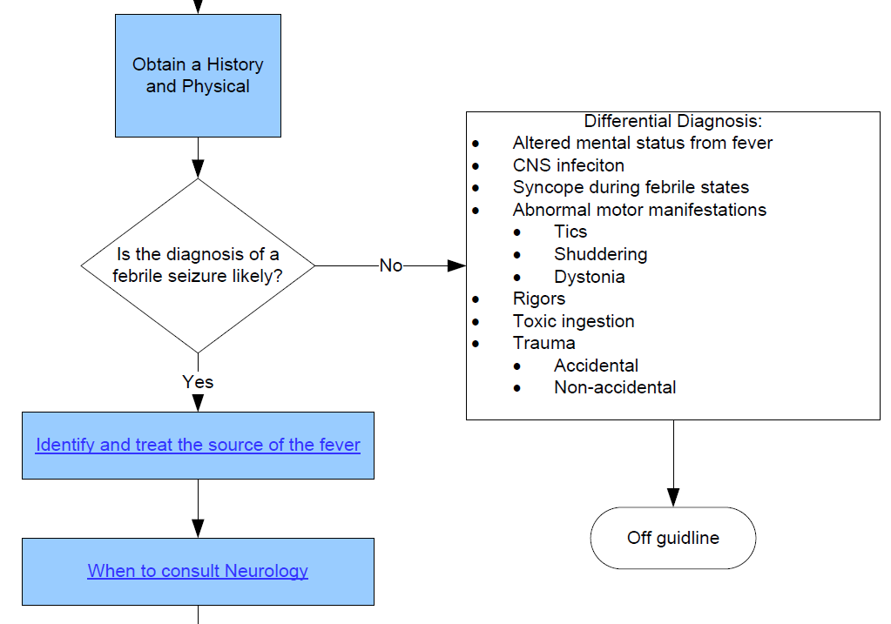
CPG Complex Febrile Seizure
Notes:
The history and physical is the same recommendations for the simple febrile seizure. History: Include (a) characteristics of the seizure, (b) duration, (c) focal attributes such as sidedness, (d) recent immunizations, and if immunization status is current, (e) family history of seizure and or developmental delay, (f) loss of consciousness. Physical Exam (PE)/Monitoring: General physical exam and neurological exam, status of fontanelle (age dependent), muscle tone and or strength.
Identify and treat the source of fever is the same for simple febrile seizure. The goal is to find the source of fever and Lumbar puncture is still not recommended unless it aids in finding the source of fever.

Slide 25
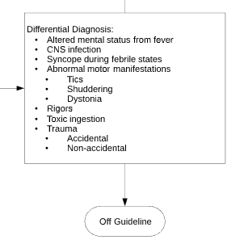
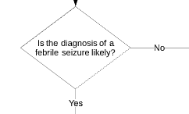
CPG Complex Febrile Seizure
Notes:
Is the dx of seizure likely? If yes, move on to identifying and treating the source of fever. If not, you must consider differential diagnoses which will take you off the guideline.

Slide 26
CPG Complex Febrile Seizure
Non-urgent outpatient follow-up is recommended for complex febrile seizure
No consensus was reached for phone consult.
Notes:
If prolonged focal neurological deficit with a suspicion of status epilepticus or seizure duration greater than 5 minutes or a series of seizures that grouped together last > 30 minutes. (This child is off our guideline)
A higher percentage of neuro/ed/hospitalists said they would call neuro for complex febrile seizure but less said they would call them for simple.

Slide 27
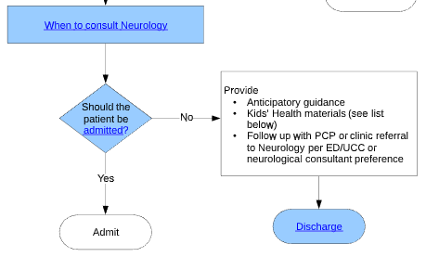
CPG Complex Febrile Seizure
Notes:
Slide with lower half of algorithm on it

Slide 28
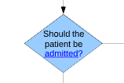
CPG Complex Febrile Seizure
Consider hospital admission when:
The patient’s clinical status is unstable OR
The infection causing the fever requires hospitalization for treatment OR
Significant parental anxiety OR
The home situation is unclear OR
Transportation home or back to the hospital, if needed, is not reliable

Slide 29
CPG Complex Febrile Seizure
Emergency department/Urgent Care discharge criteria
Cause of the fever can be treated as an outpatient
Patient has returned to neurological baseline
Follow up plan is created; parents are educated on plan
Parents are comfortable with the treatment and care plan
Transportation home or back to the hospital, if needed, is reliable

Slide 30
CPG Complex Febrile Seizure
DON'T FORGET
Notes:
Some of these tests will ultimately be done by Neurology but NONE need to be done urgently or emergently.

Slide 31
Seizure First Aid
Place child on side and protect them from injury.
Make note of the time.
Make note of all movements.
Do not give any medications by mouth.
Call 911 if seizure is lasting 5-10 minutes.
Record event if able.

Slide 32
Anticipatory guidance
Will my child have another seizure?
Only 20-25% of typically developing, otherwise healthy children will experience recurrence of seizures. This means 75% or more will not have any further seizure activity
Could my child die if it happens again?
Death after a first recurrence of a simple febrile seizure has never been reported.
Does brain damage occur?
Brief seizures do not cause brain damage.
https://patiented.solutions.aap.org/handout.aspx?resultClick=24&gbosid=156447
Notes:
AAP has a great handout for families that can be found on their website that goes over febrile seizures and what to do/look for.

Slide 33
Precautions for Families
What special precautions should we take with our child?
Children should not be left unattended in any amount of standing water . Showers are okay as long as an adult is aware the child is in the shower and the door is not locked. A trusted adult should directly supervise the child in swimming pools, not just the lifeguard.
Children may participate in athletics as long as they wear a helmet when appropriate for a given sport, as would any other child.
Children should wear a helmet when operating any wheeled devices (tricycle, bicycle, scooter, roller skates, etc).
Children should be supervised at heights (monkey bars, etc).
Older children/adolescents should not cook over an open flame/stovetop for risk of injury. Microwave use is okay.
Adolescents of driving age may not operate a vehicle for 6 months after a seizure as per Kansas and Missouri law. These laws vary by state. Adolescents may resume driving after achieving 6 months of seizure freedom.
Notes:
Check your state laws so that you can offer guidance to patients after seizures, obviously these adolescents would not be in the category of a typical febrile seizure but good to know what to offer other families who present with patients with seizure activity.

Slide 34
Clinical Practice Guidelines
Available at Childrensmercy.org
Click on link in top right corner for HEALTHCARE PROFESSIONALS
On right side of the screen, there is a link to EVIDENCE BASED PRACTICE

Slide 35
References
Nathan W. Mick, Rosen's Emergency Medicine: Concepts and Clinical Practice, Chapter 166, 2058-2068.e2
Bassel W. Abou-Khalil, Martin J. Gallagher, Robert L. Macdonald Bradley's Neurology in Clinical Practice, 101, 1563-1614.e13
Mohamad A. Mikati, Abeer J. Hani, Nelson Textbook of Pediatrics, Chapter 593, 2823-2857.e1
CMH Febrile Seizure Care Card
American Academy of Pediatrics. Subcommittee on Febrile Seizures. Febrile seizures: guideline for the neurodiagnostic evaluation of the child with a simple febrile seizure. Pediatrics. 2011; 127( 2): 389– 394; doi: 10.1542/peds.2010-3318
American Academy of Pediatrics. Subcommittee on Febrile Seizures. Febrile Seizures: Clinical Practice Guideline for the Long-term Management of the Child With Simple Febrile Seizures. Pediatrics. 2008; 121 (6): 1281-1286

Slide 36
Questions??
THANK YOU!!

