Slide 1
Improving Communication in Urgent Care Handoffs: "We Need to Talk"
Amanda Nedved, MD
Director of Quality Improvement for Urgent Care
Children's Mercy Kansas City
October 31, 2019

Slide 2
Disclosures
I have no relevant financial relationships or conflicts to disclose

Slide 3
Following this webinar, participants will be able to...
Identify the most common cause of serious medical errors
Recognize standardized communication tools that can help reduce medical errors
Compare effective communication tools used during handoffs
Evaluate the use of I-PASS in improving communication with admission handoffs in the urgent care
Recognize the benefits and limitations of using objective tools to assess risk of clinical deterioration and communicate this risk to other care team members

Slide 5
What is a Handoff?
"A transfer and acceptance of patient care responsibility achieved through effective communication. It is a real-time process of passing patient specific information from one caregiver to another or from one team of caregivers to another for the purpose of ensuring the continuity and safety of the patient’s care"
The Joint Commission Center for Transforming Healthcare. Improving transitions of care: Hand-off communications. Oakbrook Terrace, Illinois: The Joint Commission, 2014.

Slide 6
Ineffective Handoffs are a Patient Safety Issue
Between 2009-2013, communication failures in U.S. hospitals and medical practices were responsible at least in part for 30% of all malpractice claims, resulting in 1,744 deaths and $1.7 billion in malpractice costs over five years.
an estimated 80% of serious medical errors involve miscommunication between caregivers during the transfer of patients.
CRICO Strategies. Malpractice risk in communication failures; 2015 Annual Benchmarking Report. Boston, Massachusetts: The Risk Management Foundation of the Harvard Medical Institutions, Inc., 2015

Slide 7
Multidisciplinary Staff
UC Providers
Subspecialist
UC Provider
PCPs
Patient
ED Provider
Patient Family
Inpatient Provider

Slide 8
First Step: Admit We Have a Problem
Givers of information perceive the handoff to be better than the Receiver of information
Senders assessed 21% of hand-offs to be unsuccessful.
Receivers assessed that 37% of the hand-offs were unsuccessful.
Drivers of ineffective communication
Cognitive biases result in insufficient or misleading information
Diagnostic uncertainty
Lack of time
Poor timing between sender and receiver
Interruptions or distractions
Contradictory goals between UC and inpatient provider
Lack of standardized procedures
In 2017, 69% of clinical learning environments did not have a standardized hand-off process

Slide 9
Joint Commission Recommendations for Handoffs
Real-time communication (Face to Face preferred)
Telemedicine?
At a minimum, include the following:
Sender contact information
Illness severity
Patient summary: events leading up to illness or admission, hospital course, ongoing assessment, and plan of care
To-do action list
Contingency plans
Allergy list
Code status
Medication list
Dated laboratory tests
Dated vital signs
Ensure adequate time and opportunity for questions
Use a mnemonic to structure handoff and improve consistency among team members
SBAR
I-PASS
Mnemonic is simply a framework and should be supported
Training
Culture Change

Slide 10
Joint Commission Recommendations for Handoffs
Eliminate interruptions and distractions
Incorporate multidisciplinary team information
Shared decision making
Do NOT rely on family members to relay vital information
Standardize training
Observation and performance feedback
Role-playing and simulation
Emphasize the "Why"
Integrate the process into the EHR
Collect data to inform next steps
What worked well
Look at special causes and abnormality trackers

Slide 11
Standardized Handoffs Provide
Memory Trigger
Omitted information and faulty communication processes were identified as the root cause of most errors linked to ToCs
Opportunity to ask and respond to questions
Mitigation of authority gradients
Mitigation of experience gradients
Decreased diagnosis momentum
Discourages narrative reporting to decrease framing effect and other cognitive biases

Slide 12
Notes:
A 2014 study snowed implementing a standardized handoff from the ED to inpatient decreased handoff related care-failures from 37.2% to 13.4%. Staff satisfaction doubled during the same period

Slide 13
"Hand-offs should be highly reliable, conducted in a high-quality manner for every patient, every day, with every transition of care."

Slide 14
ISBAR
SITUATION
BACKGROUND
ASSESSMENT
RECOMMENDATION
IDENTIFICATION

Slide 15
History of ISBAR
First used in the military (SBAR); spread to other
Introduced to rapid response teams at Kaiser Permanente in 2002 to improve patient safety

Slide 16
Identify
Identify yourself and your location
Confirm who you are speaking with and their location
Identify the patient by name

Slide 17
Situation
Give the patient’s reason for admission
Explain significant medical history
Inform the receiver of the information of the patient’s background
Pertinent medical/social/family history
Events leading up to UC visit
UC course including meds given, lab and other relevant diagnostic results.

Slide 18
Assessment
Vital signs
Clinical impressions, concerns.

Slide 19
Recommendation
Explain what you need – be specific about request and time frame
Make suggestions
Clarify expectations

Slide 20
Using ISBAR
Improved employee satisfaction
Improved perception of communication and interdisciplinary teamwork especially during patient handoffs
Decreased time needed for handoffs
Decreased unexpected deaths in an adult study of nurse-physician phone communication
Müller M, Jürgens J, Redaèlli M, et al. Impact of the communication and patient hand-off tool SBAR on patient safety: a systematic review BMJ Open 2018;8:e022202. doi: 10.1136/bmjopen-2018-022202

Slide 21
I-PASS
ILLNESS SEVERITY
PATIENT SUMMARY
ACTION LIST
SITUATION AWARENESS/CONTINGENCY PLANNING
SYNTHESIS BY RECEIVER

Slide 22
History of I-PASS
Started at Boston Children's Hospital in 2010
Multi-center trial in 2014
Associated with
30% reduction in overall error rates
23% reduction in rate of preventable adverse events
Improvements in perception of verbal and written handoff communications
No significant adverse effect on resident workflow or handoff duration

Slide 23
I-PASS at Children's Mercy Kansas City
Started on resident inpatient teams in 2014
Adopted by Infectious Disease providers for inpatient consult handoffs
Modified for urgent care to inpatient handoffs in July 2018
Champions for UC and PHM modified handoff tool
Pre-intervention survey
Visual aids
Provider education
UC provider simulation
Feedback

Slide 24
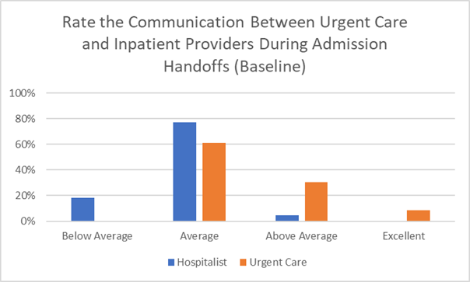
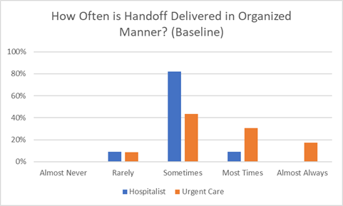
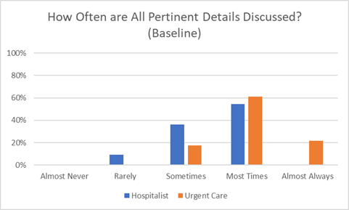
Provider Perception of Communication During Admissions - Pre-Intervention Survey

Slide 25
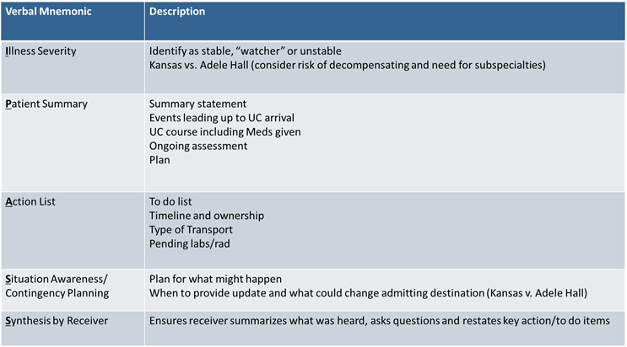
Aim Statement
All providers at Children’s Mercy Urgent Cares will use complete I-PASS (all 5 components verbalized) during verbal admission handoffs to general pediatric (med/surg) teams at least 75% of the time by May 31, 2019.

Slide 26
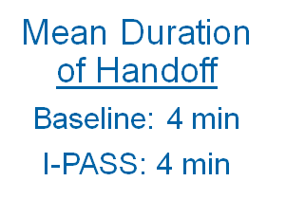
*Physician participants received monetary incentive if goal was reached. MOC Part 4 credit was also offered to physicians

Slide 27
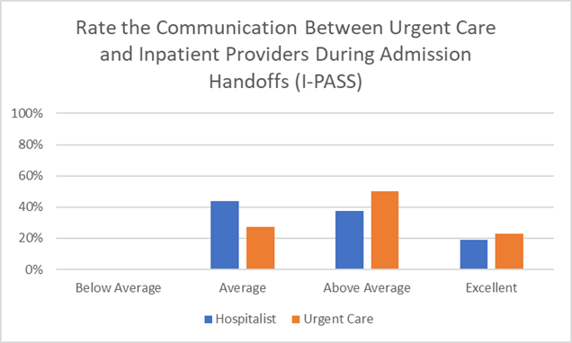
Post-Intervention Survey

Slide 29
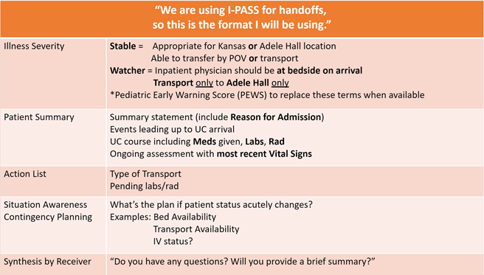
What We Learned
Standardized handoffs improve communication without impeding provider workflow
Subjective terms for Illness Severity do not translate well from UC to inpatient
Collaborate with inpatient or ED providers to learn what they consider essential information during handoffs

Slide 30
Next Steps
Look at clinical impact
Transfer to higher LOC
Adverse events/Incident reports related to communication
Implemented objective illness severity score (PEWS) in October 2019

Slide 31
History of Pediatric Early Warning System (PEWS)
Developed at Sick Children's Hospital
Initially a 7 category score ranging from 0-26
Many variations developed since the original
Common scoring is now 5 category (0-13)
Behavior
Cardiovascular
Respiratory
Continuous breathing treatment
Postoperative vomiting

Slide 32
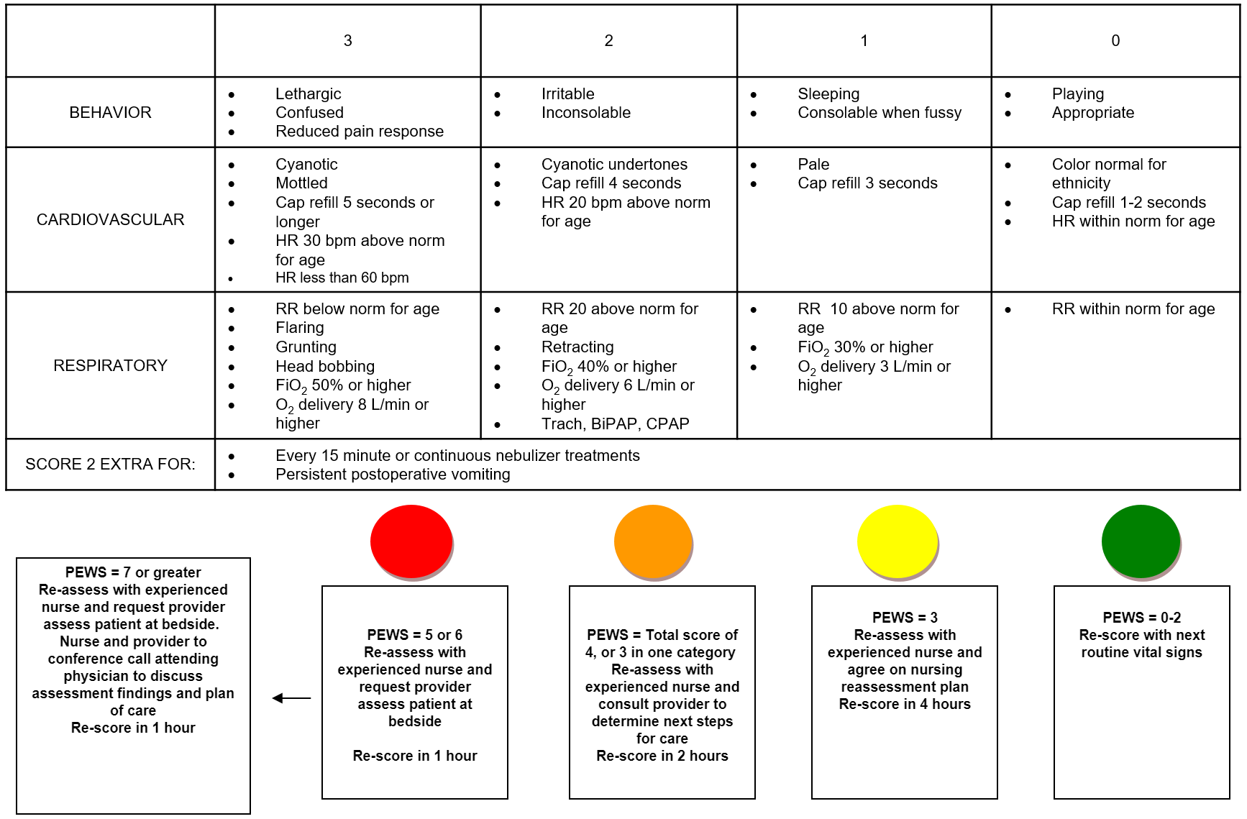
Pediatric Early Warning Score (PEWS)

Slide 33
PEWS in the ED
Provides continuity of assessment
Better outcomes when correlated to specific actions and integrated into EMR
Score ≥3 good specificity but poor sensitivity for predicting admissions
High PEWS should be taken seriously
Low PEWS does NOT rule out need for admission
Need to account for entire clinical picture
Fever elevates scores
Bronchiolitis can have low scores but high risk for decompensation

Slide 34
PEWS at Children's Mercy
Started in 2010 to decrease codes outside of ICU, increase situational awareness and improve communication
Spread to transport and emergency department
Go-live date for PEWS in urgent care: Oct 15, 2019

Slide 35
PEWS obtained on all high-acuity patients, transfers and admits

Slide 36
Summary – Key Points
Communication errors are the most common cause of serious patient safety events
Standardized handoffs like I-PASS, ISBAR can be modified to improve communication
Collaborate with other specialities (ED, hospital medicine, etc.) to identify essential components of handoff and develop a standard format that works for everyone
Subjective terms for illness severity did not translate well between UC and inpatient at our institution.
It is still to early to determine effect of objective score in UC; however, studies recommend using it as a tool to communicate ongoing assessment and have trigger points

